Slide 1
Significant Changes to the 2018 NCBC
Based on the 2015 International Building Code® (IBC®)
& Amendments Approved by the NC Building Code Council

Slide 2
Goal
The goal of Significant Changes to the 2018 NCBC is to familiarize building officials, fire officials, plans examiners, inspectors, design professionals, contractors, and others in the construction industry with many of the important changes in the 2015 International Building Code® (IBC®) and the amendments approved by the NC Building Code Council which, when combined together, will make up the 2018 NCBC.

Slide 3
Topics
Building Height & Area, Chapter 5
Fire Protection, Chapter 7
Means of Egress, Chapter 10

Slide 4
Marginal Markings within the 2015 IBC
Solid vertical lines in the margins within the body of the code indicate a technical change from the requirements of the 2012 edition.
Deletion indicators in the form of an arrow are provided in the margin where an entire section, paragraph, exception or table has been deleted or an item in a list of items or a table has been deleted.
A single asterisk [*] placed in the margin indicates that text or a table has been relocated within the code.
A double asterisk [**] placed in the margin indicates that the text or table immediately following it has been relocated there from elsewhere in the code.
*
**

Slide 5
Letters in Front of IBC Section Numbers
In each code development cycle, proposed changes to the code are considered at the Code Development Hearings.
Proposed changes to a code section that has a number beginning with a letter in brackets are considered by a different code development committee.

Slide 6
Letters in Front of IBC Section Numbers
The content of sections in this code that begin with a letter designation is maintained by another code development committee:
[A] = Administrative Code Development Committee;
[E] = International Energy Conservation Code Development Committee;
[EB] = International Existing Building Code Development Committee;
[F] = International Fire Code Development Committee;
[FG] = International Fuel Gas Code Development Committee;
[M] = International Mechanical Code Development Committee; and
[P] = International Plumbing Code Development Committee.
Notes:
Definitions by the Admin committee or chimneys by the Mechanical Committee

Slide 7
Chapter 5

Slide 8
503 General Building Height and Area Limitations
Table 503 has been replaced with separate tables addressing maximum allowable:
Height in feet above grade plane
Height in stories above grade plane
Floor area in square feet
Notes:
The IBC regulates the size of buildings in order to limit to a reasonable level the magnitude of a fire that potentially may develop. The size of a building is controlled by its floor area and height, both of which are limited by the IBC. Although floor-area limitations are concerned primarily with property damage, life safety is enhanced as well by the fact than in the larger buildings there are typically more people at risk during a fire. Height restrictions are imposed to primarily address egress concerns and fire department access limitations. The provisions regulating building height and area limitations have been extensively revised in order to provide an increased degree of user-friendliness and
technical consistency.
Table 503, representing the unmodified base allowable area and height data, has historically been the starting point in the determination of all three limiting conditions; a building’s allowable height in feet, its allowable height in stories above grade plane and its allowable floor area per story. The limiting values in Table 503 of the 2012 IBC have now been separated into three separate tables and placed in context at the appropriate technical sections for the design or review process. In addition, the allowable values within the new tables represent whether or not the building is sprinklered, and if it is sprinklered, the type of sprinkler system provided. Occupancy classification and construction type continue to be the other required variables necessary to determine the maximum allowable height and area of a building.
Integrating all three required variables into the three revised tables effectively eliminates or seamlessly incorporates many of the previous
provisions and exceptions, reducing misinterpretation of the code’s intent. In addition, the revised format uses new terminology, along with changes in organization, to improve on a somewhat confusing multistep process for value determination. Through an improved sequential format and technical consolidation, this process has been simplified, resulting in consistent allowable height and area determinations.
Because Code Change G101-12, as amended, extensively revised the allowable height and area provisions of Sections 503, 504 and 506, the entire code change text is too extensive to be included here. Refer to the 2015 IBC Code Changes Resource Collection for the complete text and rationale of the code change.

Slide 9
T504.3 Building Height in Feet Above Grade Plane
^{I}
Notes:
CHANGE TYPE: Clarification
CHANGE SUMMARY: In order to increase the degree of user-friendliness of the process by which the allowable building height provisions are determined, Table 503 has now been reformatted as Tables 504.3 (allowable height in feet) and 504.4 (allowable number of stories above grade plane), and any applicable sprinkler increase has been incorporated directly into the new tables.

Slide 10
T504.4 Building Height in Stories Above Grade Plane

Slide 11
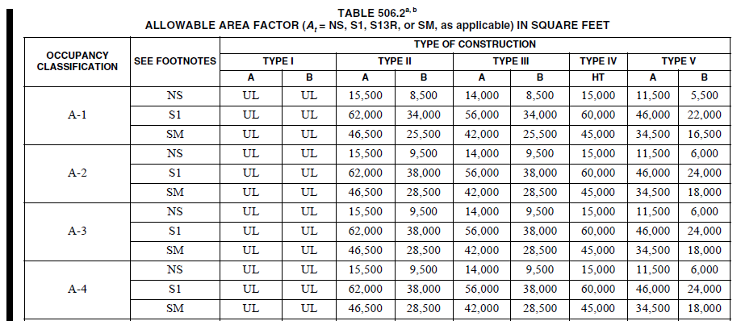
T506.2 Allowable Building Area

Slide 12
Reason continued: A comparison of the 2012 and 2015 allowable area and height determination procedures reveals a much more simple process and identical answers to the exercise:
GIVEN:
Occupancy classification: Group B
Actual number of stories: 4
Actual Height above grade plane: 80’
Actual floor area/story = 100,000 sq. ft. (400,000 aggregate floor area for the entire building)
Type of construction: Type IIA
Sprinkler protection: NFPA 13
Frontage: around the entire building has 50 feet open space (100% open)
This change reduces the path to compliance from 10 steps using the ‘12 IBC to 8 steps using the ‘15 IBC
Notes:
As a general rule, the IBC applies to any structure undergoing construction, alteration, relocation, enlargement,
replacement, use and occupancy, repair, maintenance, removal, or demolition.
However, the exception to Section 101.2 indicates that the IRC is to be applied to specified residential buildings, along with their accessory structures. The IRC has previously limited the area and height of such accessory structures through the definition of “accessory structure” in Section R202. That definition has been deleted, in effect limiting the height of an IRC accessory structure to the dwelling unit/townhouse limit of three stories above grade plane. The modifications in the IRC provisions have been reflected in the exception to IBC Section 101.2.
The IRC has previously limited accessory buildings to 3000 square feet and two stories in height. The 2015 IRC no longer contains these limitations, but rather only limits the height of an accessory structure to the scoping height of those dwellings and townhouses regulated by the IRC.
As a side note, the IRC no longer places a floor area limitation on accessory structures. It was determined that the more appropriate approach to limiting the size of a residential accessory structure is through local
Zoning ordinances.

Slide 13
507.1 Basements in Unlimited Area Buildings
The allowance of a single-story basement in unlimited area buildings has now been clarified.
Although there was never a specific prohibition, it was unclear as to the intent of the provision.
“Basements not more than one story below grade plane shall be permitted.”
Notes:
One of the key concepts in the application of the unlimited area building provisions of Section 507 is the limitation on building height. In order to provide the degree of fire department access necessary to address such buildings under fire conditions, a limit on vertical travel has always been an important element of the overall
level of fire safety. Unlimited area buildings permitted by Section 507 cannot exceed two stories in height above grade plane, and in some cases a limitation of one story is established. The allowance for a single-story basement in such buildings, which has previously never been specifically addressed, is now clearly set forth in Section 507.1. The allowances for various types of unlimited area buildings specifically all include conditions regulating the maximum number of stories that are permitted above the grade plane. In previous code editions, there has been no mention of how to address a story that is considered a basement. Although there was no specific prohibition of basements in unlimited area buildings, there has been much confusion as to the appropriateness of such a condition. In order to maintain consistency in relation to the level of exit discharge, basements are limited to one story below grade plane.

Slide 14
507.4 Non-separated Mixed Occupancy in Unlimited Area Building

Slide 15
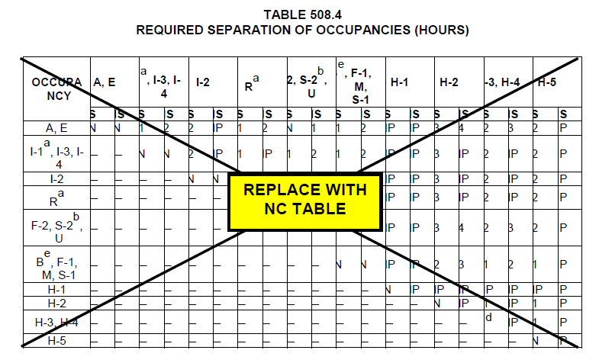
T508.4 Replaced with NC Table

Slide 16
Footnotes to NC T508.4

Slide 17
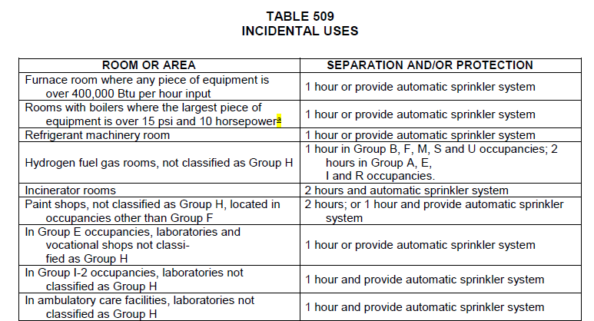
T509 Incidental Uses

Slide 18
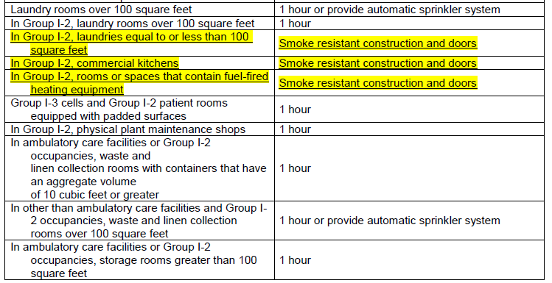

Slide 19
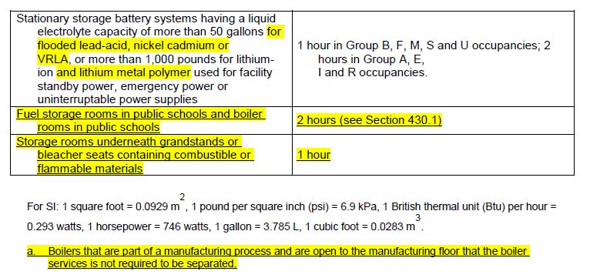

Slide 20
510.2 Horizontal Building Separation
In the special provisions of Section 510.2 addressing pedestal buildings, there is no longer a limit of one story above grade plane for that portion of the structure that occurs below the 3-hour horizontal separation.
Upper ‘building’ height in feet continues to be based on height above grade plane.
Occupancies permitted below horizontal separation expanded to include all occupancy classifications except Group H.
Notes:
Section 510.2 is one of a handful of provisions
in the IBC that permits structures to be divided horizontally in
such a manner that the portions of the structure above and below a fire-resistance-
rated horizontal separation can each be considered as separate
buildings when applying specified provisions of the code. The IBC makes
provisions for the use of a minimum 3-hour fire-resistance-rated horizontal
assembly as an equivalent construction feature, in certain aspects, to a
fire wall. This methodology is often referred to as a “podium,” “pedestal,”
or “platform” building. Two key conditions have been modified, resulting
in a change in application of the provisions.
Historically, as regulated by Item 2, the portion of the building below the
3-hour horizontal separation has been limited to one story above grade
plane. At that point, the upper building is limited to the total number of stories
as permitted in Table 503 along with any applicable sprinkler increase
based on Section 504.2. As a result, the net benefit in the application of Section
510.2 has previously been limited to a one-story increase in overall
building height. There is now no limit to the number of stories above grade
plane that occur below the horizontal separation, provided the total building
height in feet, measured from grade plane to the average height of the
highest roof surface, does not exceed the allowable building height in feet.

Slide 21
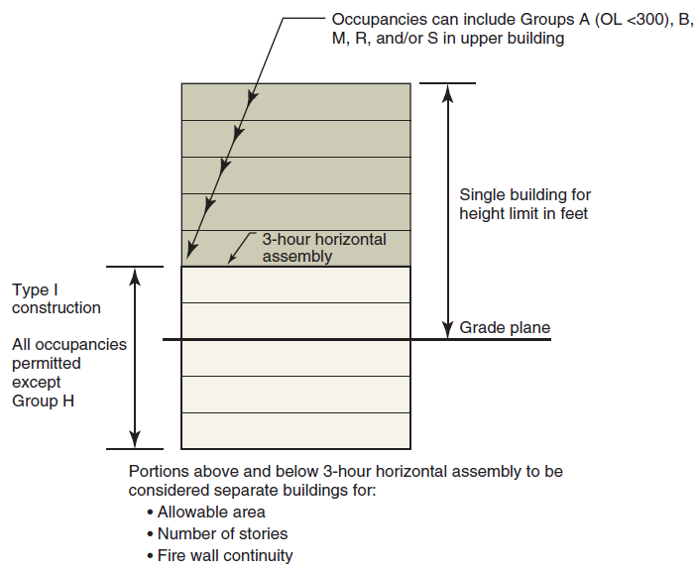
510.2 Horizontal Building Separation
Notes:
Building height still limited by occupancy and construction type as set forth in Table 504.3
Fire protection and life safety are better served where the building is built to its highest required construction type, Type IA. By limiting the Type IA portion, the code has previously created conditions where the majority of the structure was of a lower type of construction. Multiple stories of Type IA construction are now permitted below the upper building, and the limitation on total allowable building height in feet continues to be maintained.
Item 6 previously placed a limit on the occupancy classifications permitted below the horizontal assembly. Only those uses classified as Group A (occupant load of 299 or less), B, M, R and S could be located within the lower building. Item 6 has been expanded to now allow all occupancy groups other than Group H to be located below the 3-hour horizontal separation. Because Item 2 requires the lower building to be fully sprinklered and of Type IA construction, it was determined that the exclusion of occupancies other than Group H was inconsistent with other provisions throughout the code.
Section 510.2 has also been modified extensively in the previous editions of the IBC. When the concept was first introduced into the legacy codes, the special provisions were intended to address issues with very specific building types and uses. Over the years, it has been recognized that the concept can effectively be applied in a more broad-based manner; therefore, some of the specific limitations introduced in the initial application of the provisions continue to be modified or deleted.

Slide 22
Fire Protection
Chapters 7 through 9
Notes:
The fire protection provisions of the International
Building Code (IBC) are found primarily in
Chapters 7 through 9. There are two general categories
of fire protection: active and passive. The fire
and smoke resistance of building elements and systems
in compliance with Chapter 7 provides for passive protection.
Chapter 9 contains requirements for various
active systems often utilized in the creation of a safe
building environment, including automatic sprinkler
systems, standpipe systems and fire alarm systems. To
further address the rapid spread of fire, the provisions
of Chapter 8 are intended to regulate interior-finish
materials,
such as wall and floor coverings. ■

Slide 23
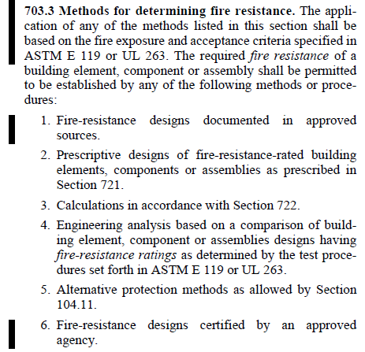

Slide 24
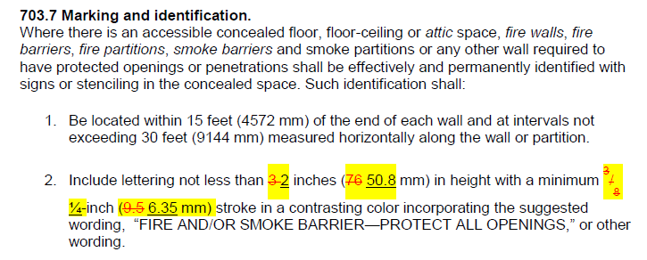
703.7 Marking of Fire or Smoke Walls

Slide 25
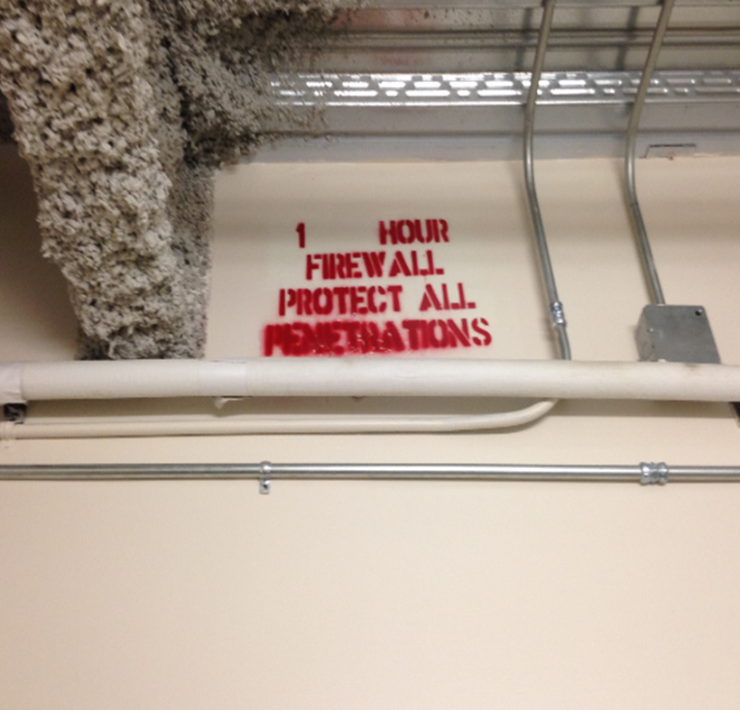

Slide 26
704.4 Protection of Secondary Members
For structural fire protection purposes, the secondary member protection requirements have been reformatted and clarify that the secondary members in a horizontal assembly can be protected by a ceiling membrane.
Also clarified that only membrane protection is required for all studs in a bearing condition, not just king studs.

Slide 27
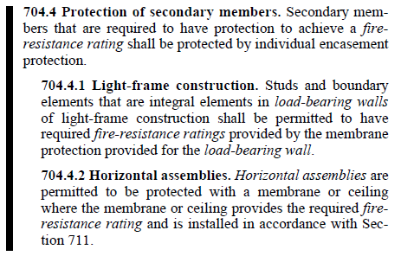

Slide 28
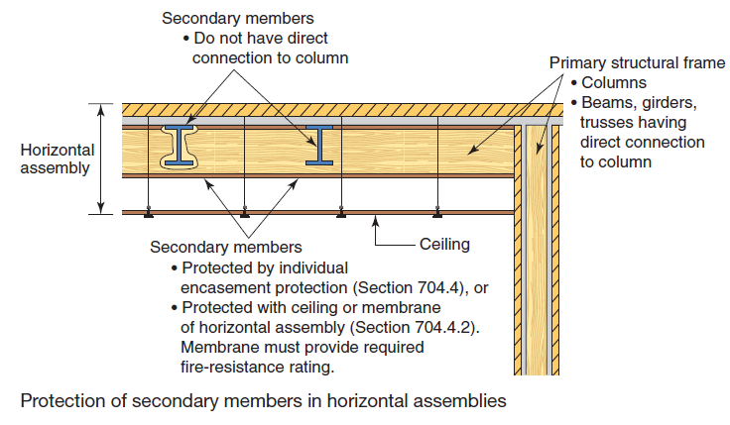
704.4 Protection of Secondary Members

Slide 29
705.3 Buildings on the Same Lot
Openings are now permitted through adjacent exterior walls of a Group S-2 parking garage and a Group R-2 building on the same lot where buildings are regulated as two buildings on the same lot and the fire separation distance is zero.
Typically, no openings would be permitted due to 0 FSD.
Applicable to a very specific condition
Group R-2 to be of Type I or II construction.
Notes:
It is not uncommon for elements of the floor and/or roof construction to provide bracing support for exterior walls.
There has been confusion as to the exact type and performance of the protection of such bracing elements that are not located in the plane of the exterior wall. The deletion of the condition based on fire separation distance should result in more consistent application by focusing on the remaining provisions to establish the proper level of protection.

Slide 30
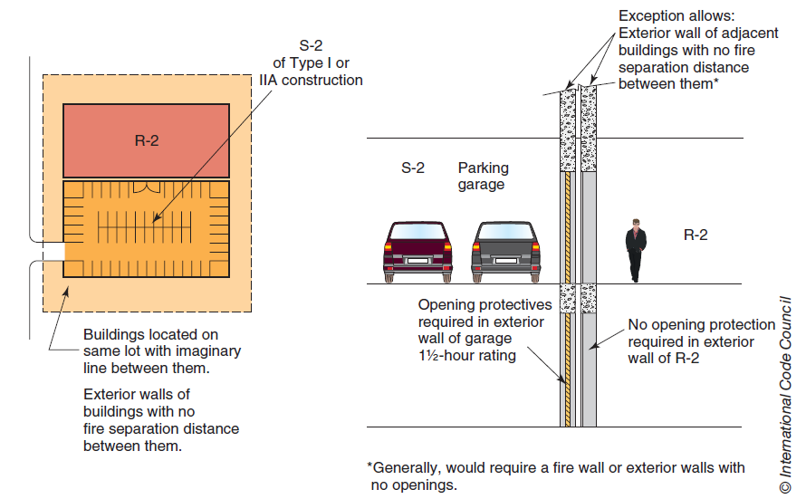
705.3 Buildings on the Same Lot
Notes:
CHANGE TYPE: Modification
CHANGE SUMMARY: Openings are permitted through adjacent exterior walls of a Group S-2 parking garage and a Group R-2 building on the same
lot where such buildings are regulated as two buildings on the same lot and the fire separation distance is zero.

Slide 31
705.6 Structural Element Bracing of Exterior Walls
Interior structural elements, such as floor or roof elements, that brace exterior walls are no longer required to be regulated for fire resistance due to the exterior wall’s rating regardless of the building’s proximity to a lot line.
Interior bracing elements, such as a floor and/or roof system, that are not in plane of exterior wall, need only be protected based on Table 601.
Intended in 2012 code change, but not fully clarified.
Provision has traditionally been interpreted in a variety of ways.
Notes:
It is not uncommon for elements of the floor and/or roof construction to provide bracing support for exterior walls.
There has been confusion as to the exact type and performance of the protection of such bracing elements that are not located in the plane of the exterior wall. The deletion of the condition based on fire separation distance should result in more consistent application by focusing on the remaining provisions to establish the proper level of protection.

Slide 32
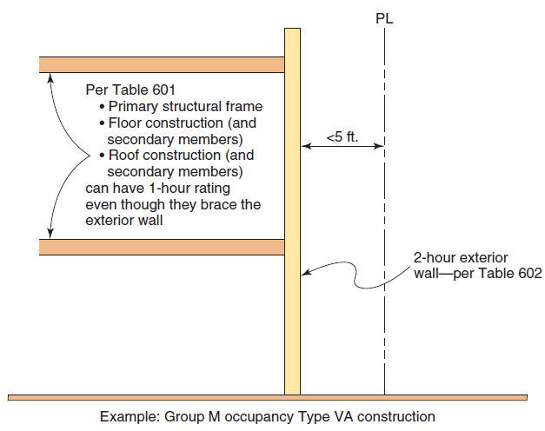
705.6 Structural Element Bracing of Exterior Walls

Slide 33
705.8.5 Vertical Separation of Openings
Where a fire-resistance-rated wall is provided to address the concern of a fire spreading out of the building and then exposing an upper-level opening, the exterior wall must be rated from both sides, regardless of the fire separation distance.
Overrides allowance by Section 705.5 for ‘fire side only’ wall where FSD exceeds 10 feet.
Typically, no exterior exposure is assumed, however in this case it is the primary consideration.

Slide 34
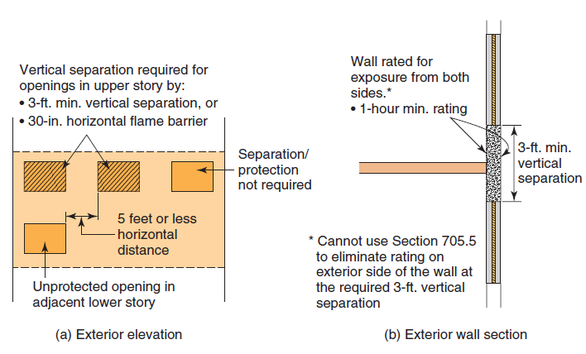
705.8.5 Vertical Separation of Openings

Slide 35
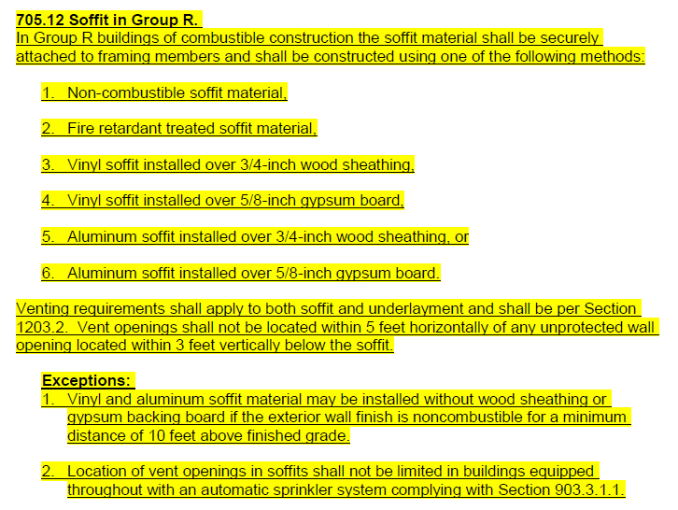

Slide 37
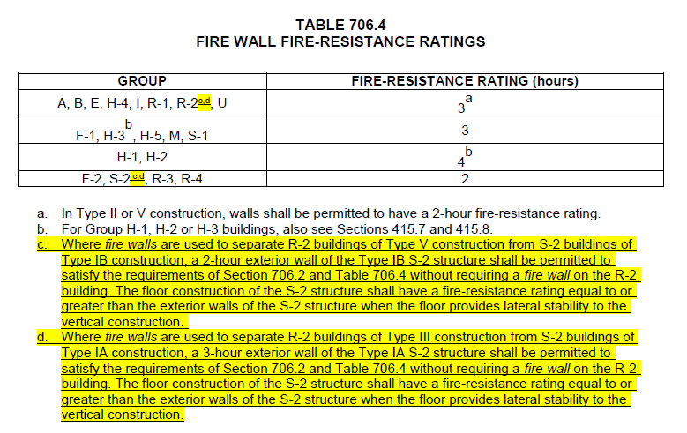

Slide 39
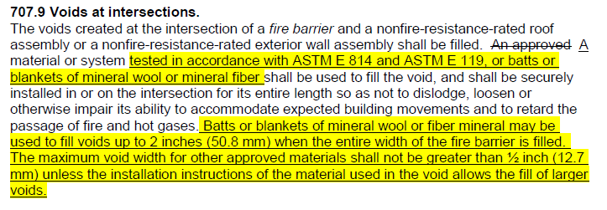

Slide 40
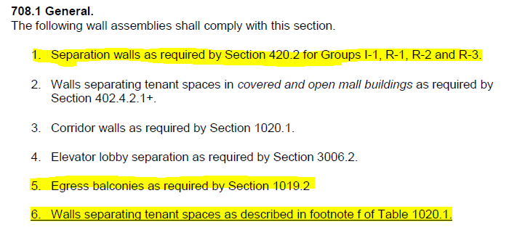

Slide 41
709.4 Continuity of Smoke Barriers
The horizontal continuity of smoke barriers has been clarified for smoke barriers used to create smoke compartments, as well as for smoke barrier walls intended to create enclosures for elevator lobbies or areas of refuge.

Slide 42
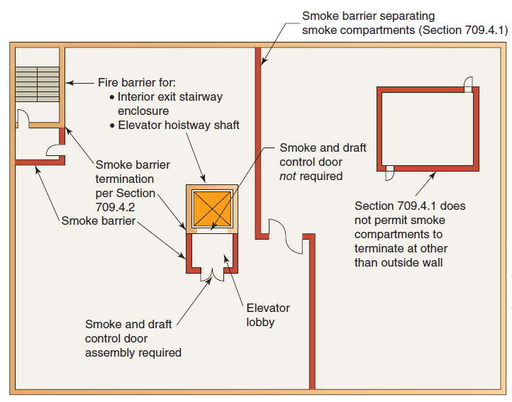
709.4 Continuity of Smoke Barriers
Notes:
Smoke compartment = outside wall to outside wall
Elevator lobby or area of refuge = outside wall, another smoke barrier wall or a fire barrier wall having a minimum 1 hr rating

Slide 43
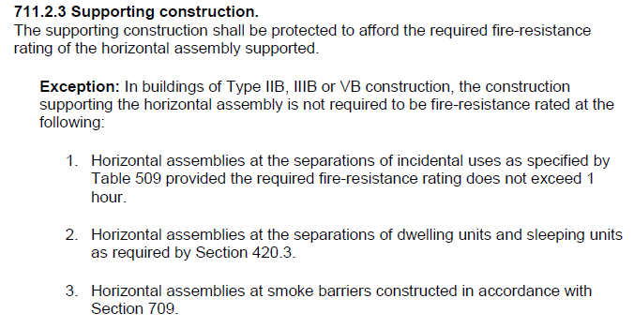

Slide 44
711, 712 Horizontal Assemblies and Vertical Openings
Section 711 retitled as “Floor and Roof Assemblies” rather than “Horizontal Assemblies” to more correctly address inclusion of “nonfire-resistance-rated” floor and roof assemblies.
Section 712 scoping now better understood due to inclusion of charging statement.
Also removed previous Condition 2 stairway prohibition in Section 712.1.9 addressing permissible two-story openings as Section 712.1.12 permits exit access stairways.

Slide 45
717.1.1 Ducts Transitioning between Shafts
Transitions permitted where exit and entry into shaft construction protected by appropriated dampers.
Not applicable where:
Dampers are prohibited in duct system, such as where hazardous exhausts are present, and
Where “continuous” duct is required, such as grease duct enclosures serving a Type I hood.

Slide 46
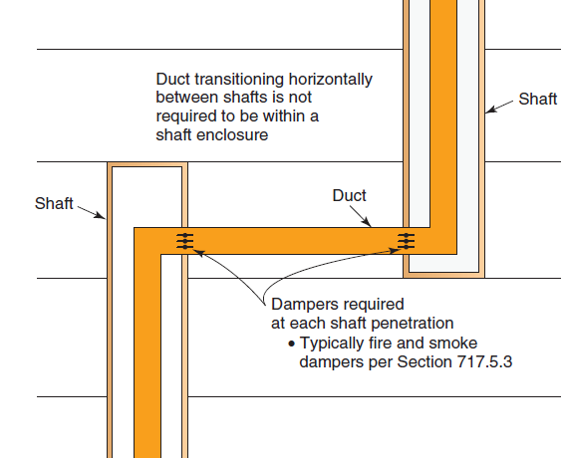
717.1.1 Ducts Transitioning between Shafts
CHANGE TYPE: Clarification
Ducts are now expressly allowed to exit a shaft, transition horizontally, and then enter another shaft without continuous shaft construction.

Slide 47
717.3, 717.5 Corridor Dampers
Corridor dampers now required for duct and air transfer openings of FRR corridor ceiling where constructed as required for corridor walls.
Corridor dampers are to comply with both UL 555 and UL 555S.
Dampers to have minimum 1-hour FRR and Class I or II leakage rating.
Required in both nonsprinklered and sprinklered buildings.

Slide 48
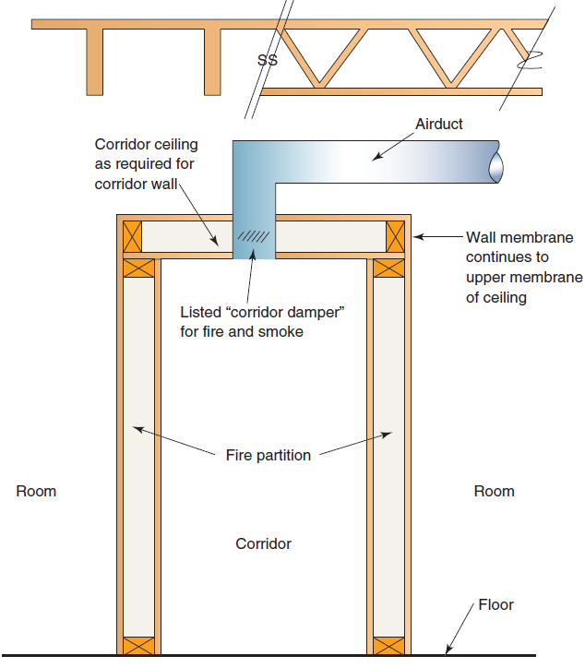
717.3, 717.5 Corridor Dampers
CHANGE TYPE: Clarification
Where a duct penetration occurs in the ceiling of a fire-resistance-rated corridor where the lid of the corridor is constructed using a corridor wall placed horizontally, a corridor damper is now specifically mandated.

Slide 49
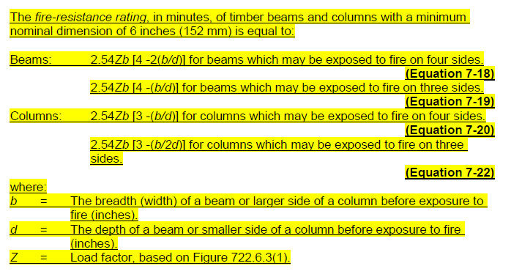

Slide 50
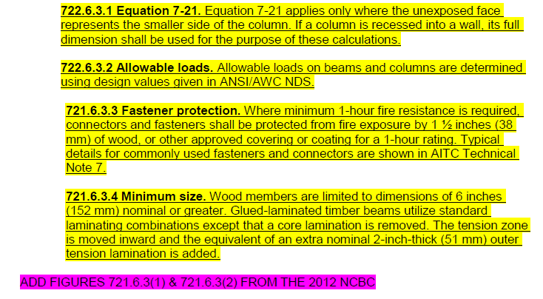

Slide 51
903.2.1.6 Sprinkler Systems— Assembly Occupancies
Limited to Group A roof occupancies and occupant loads
Not applicable to Type I and II open parking garages
Where NFPA 13R sprinkler system permitted in residential building, use of 13R system is acceptable.

Slide 52
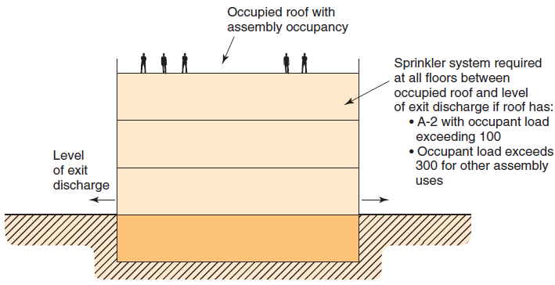
903.2.1.6 Sprinkler Systems— Assembly Occupancies
CHANGE TYPE: Addition
An automatic sprinkler system is now required to be installed where the roof is used for a Group A-2 assembly occupancy with an occupant load exceeding 100, as well as for other Group A occupancies where the occupant load exceeds 300.

Slide 53
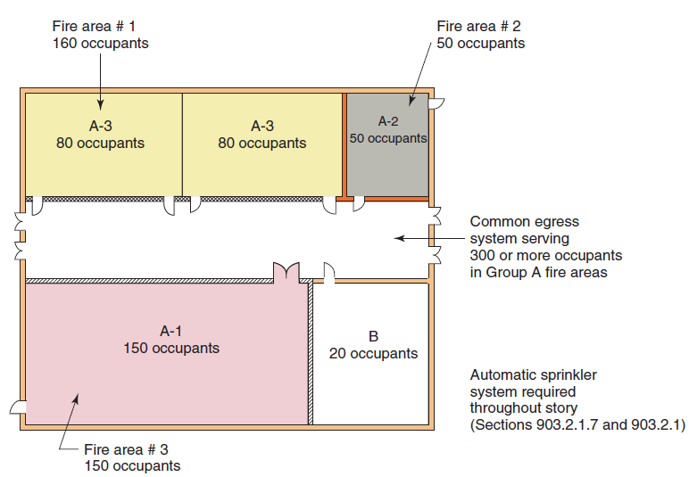
903.2.1.7 Multiple Fire Areas
Where Group A fire areas share a common means of egress, the occupant load of the spaces must now be added together to determine if a sprinkler system is required.

Slide 54
903.2.1.7 Multiple Fire Areas
This is now the only provision where occupant loads of aggregate fire areas are applied.

Slide 55
903.2.8 Sprinkler Systems— Group R Occupancies
CHANGE TYPE: Modification
Sprinkler requirements for Group R-4 occupancies are now dependent on the capabilities of the occupants.
In buildings where occupants require limited assistance when responding to an emergency condition, additional sprinkler protection is required for attic spaces.
No change in Condition 1 facilities: NFPA 13D system permitted
Condition 2 facilities: NFPA 13 or 13R required, and attics to be protected in one of two methods

Slide 56
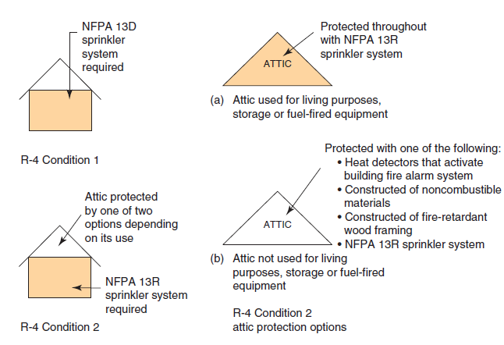
903.2.8 Sprinkler Systems— Group R Occupancies

Slide 57
903.3.8 Limited Area Sprinkler Systems
CHANGE TYPE: Modification
Additional restrictions have been placed on limited area sprinkler systems, including a reduction in the system size to a maximum of six sprinklers within a single fire area.
Previously, up to 19 sprinklers could be provided on any connection.
Notes:
Specific additional restrictions have been
placed on the design and use of limited area sprinkler systems. The most
obvious restriction is the reduction to six on the maximum number of
sprinklers
permitted. Previously, up to 20 sprinklers were allowed on
limited area sprinkler systems. In addition, although the 2012 IBC is not
specific as to how multiple limited area systems are to be provided, the
code now limits the system and the six sprinklers to a single fire area.
Previously,
it was permissible to have several separate systems protecting
a
large space. Because these limited area systems are permitted to be served
from the general domestic plumbing system as opposed to a dedicated
fire protection line, the new fire area limitation will help ensure that the
demand on the water supply can be met and reduce or eliminate the potential
need for multiple systems for any single event. Because limited
area
sprinkler systems
do not afford the same level of protection that would
be required for an NFPA 13 or 13R system, these new requirements place
additional
restrictions and controls on their design and use.

Slide 58
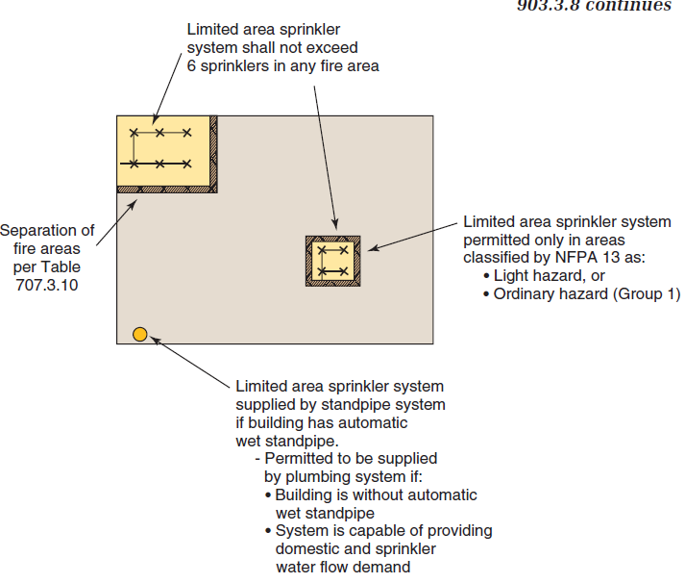
Notes:
Specific additional restrictions have been placed on the design and use of limited area sprinkler systems. The most
obvious restriction is the reduction to six on the maximum number of sprinklers permitted. Previously, up to 20 sprinklers were allowed on limited area sprinkler systems. In addition, although the 2012 IBC is not specific as to how multiple limited area systems are to be provided, the code now limits the system and the six sprinklers to a single fire area. Previously, it was permissible to have several separate systems protecting a large space. Because these limited area systems are permitted to be served from the general domestic plumbing system as opposed to a dedicated fire protection line, the new fire area limitation will help ensure that the demand on the water supply can be met and reduce or eliminate the potential need for multiple systems for any single event. Because limited area sprinkler systems do not afford the same level of protection that would be required for an NFPA 13 or 13R system, these new requirements place additional restrictions and controls on their design and use.

Slide 59
904.13 Domestic Cooking Systems in Group I-2 Condition 1
CHANGE TYPE: Addition
Requirements for domestic appliances installed within commercial facilities but used only for domestic cooking have been clarified, including provisions for an appropriate fire-extinguishing system for domestic cooking equipment in nursing homes and similar Group I-2, Condition 1 facilities.
Fire-extinguishing system for range is to be designed for domestic cooking equipment per UL-300A
Notes:
The new provisions in Section 904.13 relate
directly to other code changes in IBC Section 407.2.6 and the IMC related to
the installation and use of domestic cooking equipment in nursing homes,
assisted living facilities and similar buildings. The domestic cooking appliance
requirements of the IMC were modified to provide better guidance
on hood and exhaust system requirements for domestic cooking equipmentinstalled within facilities such as small nursing homes and assisted living
facilities where the facility may be set up in a more residential or group
home arrangement as opposed to an institutional-
type setting.7

Slide 60
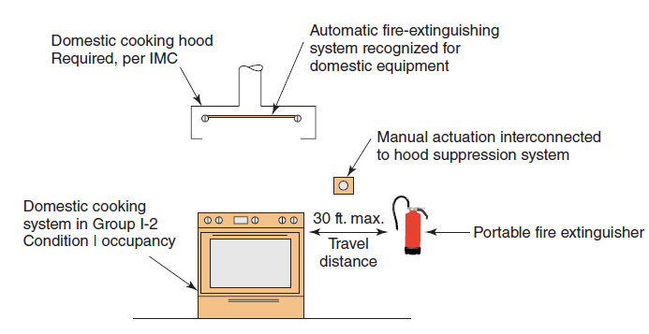
904.13 Domestic Cooking Systems in Group I-2 Condition 1
Notes:
Also requires automatic shutoff if the appliance has been on for two hours.

Slide 61
907.2.3 Fire Alarms—Group E Occupancies
CHANGE TYPE: Modification
The threshold for alarm systems in Group E occupancies has been increased such that a manual fire alarm is required where the occupant load exceeds 50, and an emergency voice/alarm communication (EVAC) system must only be provided where the occupant load exceeds 100.
Previously, both manual alarm and EVAC system triggered at 31 or more occupants.

Slide 62
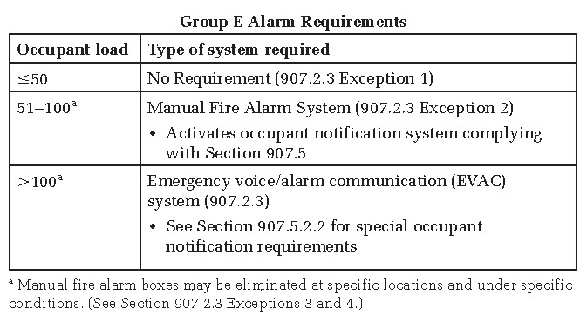
907.2.3 Fire Alarms—Group E Occupancies
Notes:
As a general requirement, all Group E occupancies must be provided with a manual fire alarm system that initiates the occupant notification signal utilizing an emergency voice/alarm communication (EVAC) system. Early notification is critical in the overall fire- and life-safety approach to educational facilities. Exception 1 in the 2012 IBC indicated that the manual alarm and EVAC systems were not required where the occupant load of the Group E occupancy did not exceed
30. The exceptions have been modified in the 2015 IBC to increase the thresholds at which both systems are now required.

Slide 63
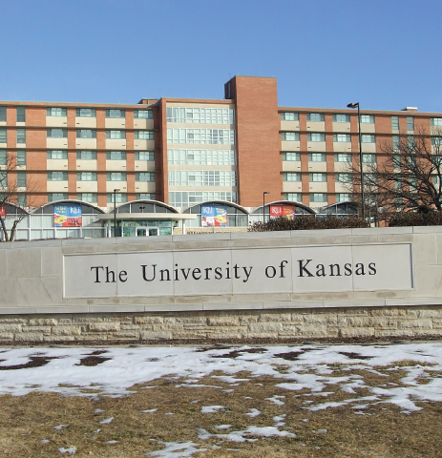
907.2.9.3 Alarm Systems— Group R-2 College and University Buildings
CHANGE TYPE: Modification
The scope of the fire alarm provisions for Group R-2 college and university buildings has been revised to apply to facilities “operated by” the college or university whether owned by the school or not and whether or not on school property.
Notes:
Due to the special hazards found in college
and university residence halls and similar residential facilities, the code has
recently increased the fire alarm requirements to a higher level than required
for other Group R-2 occupancies. The extent as to what specific buildings
are scoped by the provisions has been unclear; therefore the code has been
revised to better define what facilities are to be regulated. Previous requirements
provided no guidance as to how to define buildings and facilities that
are under the control, but not directly owned, by the college or university,
or
where the building is not located on campus property.
In the 2012 IBC, it is not clear as to how a private dormitory or an apartment
building, directly across the street from a college campus and only
rented to students, is to be regulated. As another example, a fraternity or
sorority house that might be associated with the school but is privately
owned by the local chapter or the organization’s national office was previously
difficult to evaluate. In some situations, the school may rent or control
a building that is off-campus but is owned by a private individual or corporation,
or is owned or controlled by a separate school-related entity such as
a foundation, trust or alumni association. Under the new provisions,
whether or not the college or university actually owns the building is not
important. The primary issue is whether or not the school has operational
control over the building that is used for student or staff housing.

Slide 64
907.2.9.3 Alarm Systems— Group R-2 College and University Buildings
Previously, no scope for “college buildings,” often interpreted as on campus and/or owned by college.
Provision first introduced in 2012 IBC to make requirements more consistent with those for Group R-1 occupancies:
Common spaces
Laundry, mechanical and storage areas
Interior corridors
Smoke alarms interconnected with fire alarm system
Notes:
Due to the special hazards found in college and university residence halls and similar residential facilities, the code has recently increased the fire alarm requirements to a higher level than required for other Group R-2 occupancies. The extent as to what specific buildings are scoped by the provisions has been unclear; therefore the code has been revised to better define what facilities are to be regulated. Previous requirements provided no guidance as to how to define buildings and facilities that are under the control, but not directly owned, by the college or university, Or where the building is not located on campus property. In the 2012 IBC, it is not clear as to how a private dormitory or an apartment building, directly across the street from a college campus and only rented to students, is to be regulated. As another example, a fraternity or sorority house that might be associated with the school but is privately owned by the local chapter or the organization’s national office was previously difficult to evaluate. In some situations, the school may rent or control a building that is off-campus but is owned by a private individual or corporation, or is owned or controlled by a separate school-related entity such as a foundation, trust or alumni association. Under the new provisions, whether or not the college or university actually owns the building is not important. The primary issue is whether or not the school has operational control over the building that is used for student or staff housing.

Slide 65
907.2.11.3, 907.2.11.4 Smoke Alarms Near Cooking Appliances and Bathrooms
CHANGE TYPE: Modification
Requirements from the NFPA 72 standard addressing the installation of smoke alarms near cooking appliances and bathrooms have been introduced to the IBC in order to provide direct guidance on the placement of alarms.
Applicable to required smoke alarms in Groups R-2, R-3, R-4 and I-1.
Addresses nuisance alarms due to steam
Provisions consistent with those in NFPA 72
Notes:
Smoke alarms are an effective means of providing
early detection, warning and life-safety functions, but only when
they are properly installed and maintained. If the smoke alarms are installed
incorrectly or are installed in locations where they are subject to
inadvertent activation, the occupants are likely to either disconnect the
alarms or become desensitized to their activation and ignore them when
they do sound. Some of the most frequent causes of nuisance activation
are steam or the effluent from cooking appliances, or the steam that is
produced in a bathroom.
In order to provide inspectors and installers with more direct information
on the proper placement of smoke alarms, Sections 907.2.11.3 and
907.2.11.4 have been added to the IBC. The provisions are consistent with,
and contained within, the NFPA 72 standard; however, most inspectors may
not have easy access to these specific provisions. Section 907.2.11.3 now
provides guidance related to the installation of smoke alarms near cooking
appliances depending on the type of smoke alarm used. Section 907.2.11.4
addresses the placement of smoke alarms near the door or other opening at
a bathroom that contains a tub or shower. Including the installation limitations
within the IBC is intended to reduce the number of nuisance alarms.
Therefore, it is expected that occupants will not remove or disconnect the
alarms and that the occupants’ response when the alarms do sound will
be improved.

Slide 66
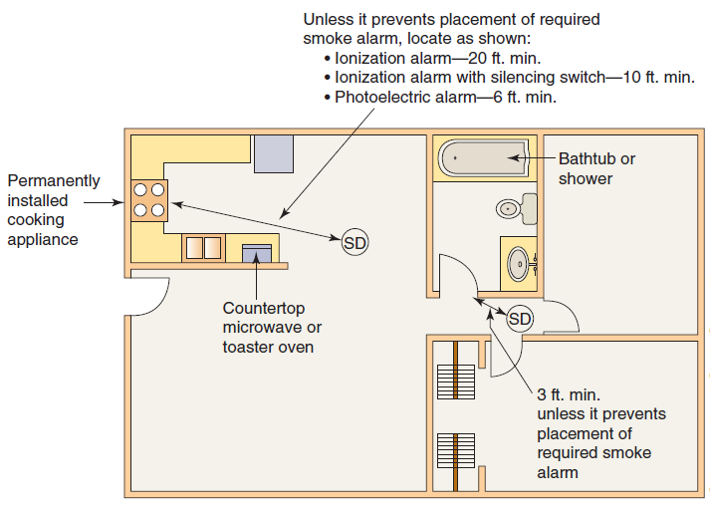
907.2.11.3, 907.2.11.4 Smoke Alarms Near Cooking Appliances and Bathrooms
Notes:
Smoke alarms are an effective means of providing
early detection, warning and life-safety functions, but only when
they are properly installed and maintained. If the smoke alarms are installed
incorrectly or are installed in locations where they are subject to
inadvertent activation, the occupants are likely to either disconnect the
alarms or become desensitized to their activation and ignore them when
they do sound. Some of the most frequent causes of nuisance activation
are steam or the effluent from cooking appliances, or the steam that is
produced in a bathroom.
In order to provide inspectors and installers with more direct information
on the proper placement of smoke alarms, Sections 907.2.11.3 and
907.2.11.4 have been added to the IBC. The provisions are consistent with,
and contained within, the NFPA 72 standard; however, most inspectors may
not have easy access to these specific provisions. Section 907.2.11.3 now
provides guidance related to the installation of smoke alarms near cooking
appliances depending on the type of smoke alarm used. Section 907.2.11.4
addresses the placement of smoke alarms near the door or other opening at
a bathroom that contains a tub or shower. Including the installation limitations
within the IBC is intended to reduce the number of nuisance alarms.
Therefore, it is expected that occupants will not remove or disconnect the
alarms and that the occupants’ response when the alarms do sound will
be improved.

Slide 67
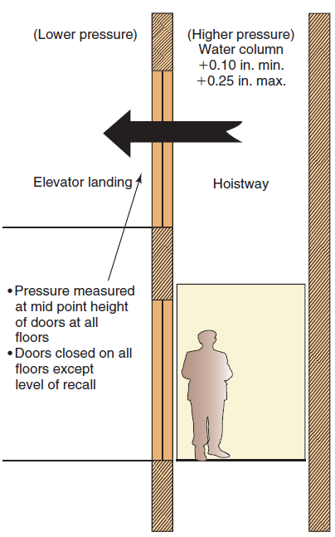
909.21.1 Elevator Hoistway Pressurization
CHANGE TYPE: Modification
Viable alternatives to the general elevator hoistway pressurization requirements are now available where pressurization is provided in lieu of an enclosed elevator lobby or an additional door.
Options provided in determining measurement of pressure differential
Notes:
Where elevator hoistway openings require
protection as a means to address vertical smoke movement, complying pressurization
is permitted as an appropriate protection option. Historically,
the general provisions of Section 909.21.1 required the hoistway
pressurization
to be measured at all floors while the elevator was located at the
recall level and the door there was open. It was shown in some studies that
this approach resulted in overpressurization at the other levels and often
interfered with the operation of the hoistway doors. A viable alternative,
based on provisions developed and used by the City of Seattle, Washington,
has now been provided to address what previously was considered as
an unworkable system.

Slide 68
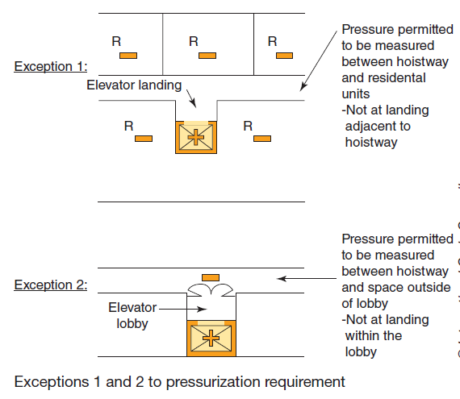
909.21.1 Elevator Hoistway Pressurization, Exception 1,2
Applicable to Group R only
Where complying lobby is provided
Notes:
Where elevator hoistway openings require
protection as a means to address vertical smoke movement, complying pressurization
is permitted as an appropriate protection option. Historically,
the general provisions of Section 909.21.1 required the hoistway
pressurization
to be measured at all floors while the elevator was located at the
recall level and the door there was open. It was shown in some studies that
this approach resulted in overpressurization at the other levels and often
interfered with the operation of the hoistway doors. A viable alternative,
based on provisions developed and used by the City of Seattle, Washington,
has now been provided to address what previously was considered as
an unworkable system.

Slide 69
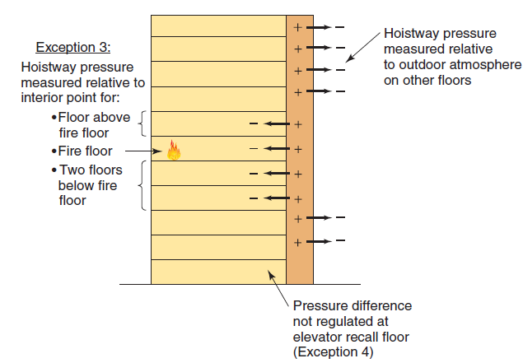
909.21.1 Elevator Hoistway Pressurization, Exception 3
Measured internally at four most critical floors
Notes:
Where elevator hoistway openings require
protection as a means to address vertical smoke movement, complying pressurization
is permitted as an appropriate protection option. Historically,
the general provisions of Section 909.21.1 required the hoistway
pressurization
to be measured at all floors while the elevator was located at the
recall level and the door there was open. It was shown in some studies that
this approach resulted in overpressurization at the other levels and often
interfered with the operation of the hoistway doors. A viable alternative,
based on provisions developed and used by the City of Seattle, Washington,
has now been provided to address what previously was considered as
an unworkable system.

Slide 70
Means of Egress
Chapter 10
Notes:
The criteria set forth in Chapter 10 regulating the
design of the means of egress are established as
the primary method for protection of people in
buildings. Both prescriptive and performance language is
utilized in the chapter to provide for a basic approach in
the determination of a safe exiting system for all occupancies.
Chapter 10 addresses all portions of the egress system
and includes design requirements as well as provisions
regulating individual components. A zonal approach to
egress provides a general basis for the chapter’s format
through regulation of the exit access, exit, and exit discharge
portions of the means of egress.

Slide 71
1004.1.1 Cumulative Occupant Loads
CHANGE TYPE: Modification
The determination of the cumulative design occupant load for intervening spaces, adjacent levels and adjacent stories has been clarified.
Design of egress path capacity to be based on cumulative portion of occupant loads along egress path
Not applicable to number of means of egress

Slide 72
1004.1.1 Cumulative Occupant Loads
Mezzanine occupant load added to room or area below for travel through lower space

Slide 73
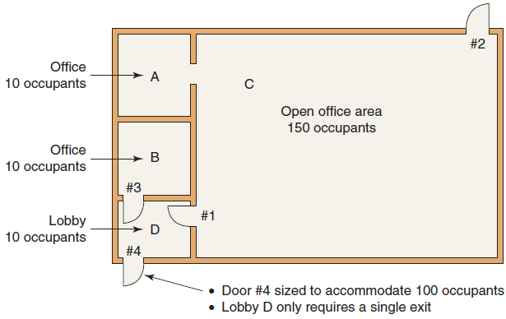
1004.1.1 Cumulative Occupant Loads

Slide 74
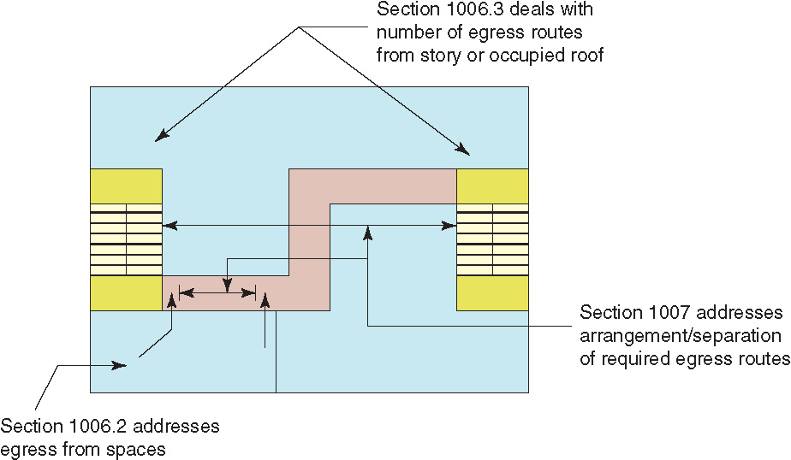
1006, 1007 Numbers of Exits and Exit Access Doorways
CHANGE TYPE: Modification
The means of egress requirements for rooms and spaces, along with those for stories, have been consolidated in Sections 1006 and 1007.

Slide 75
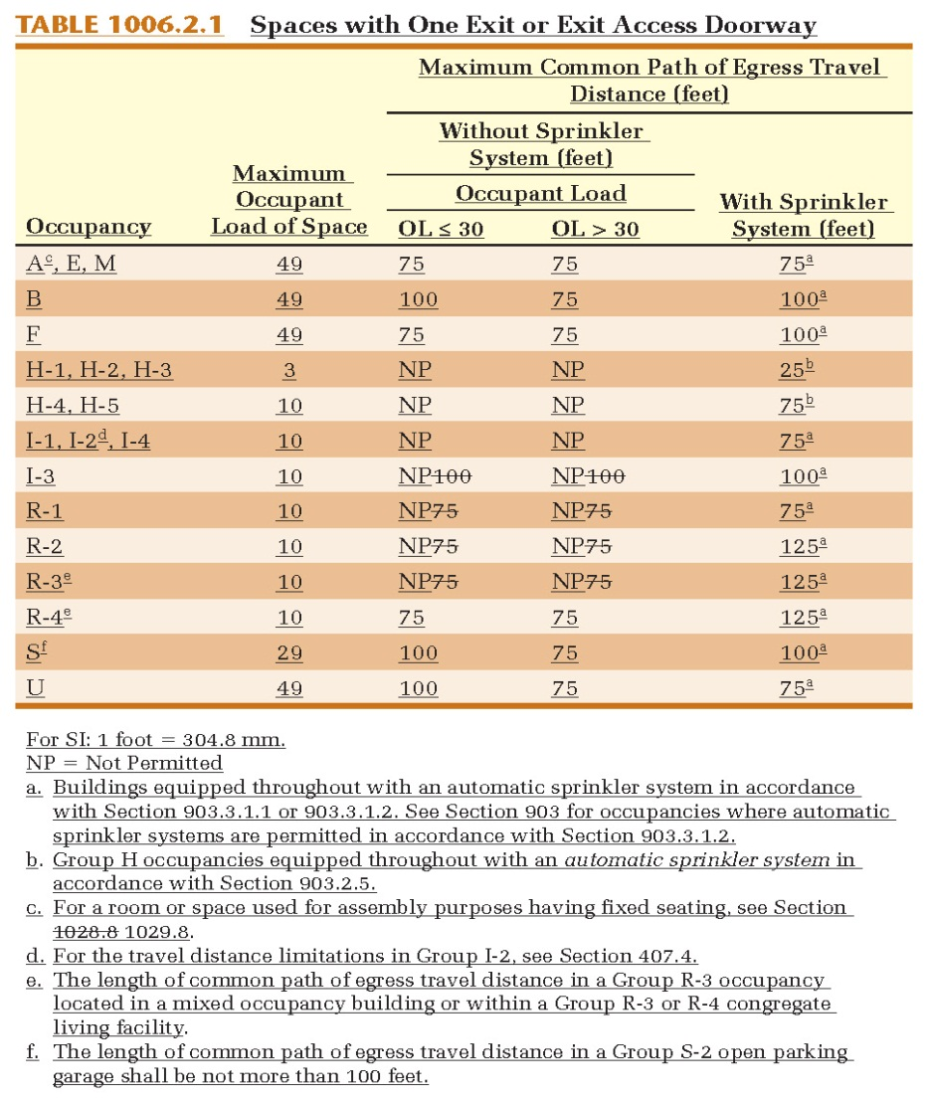
1006, 1007 Numbers of Exits and Exit Access Doorways
The limitations for spaces with one exit or exit access doorway have been consolidated into a single Table 1006.2.1, addressing both:
Maximum occupant load of space, and
Maximum common path of egress travel distance.

Slide 76
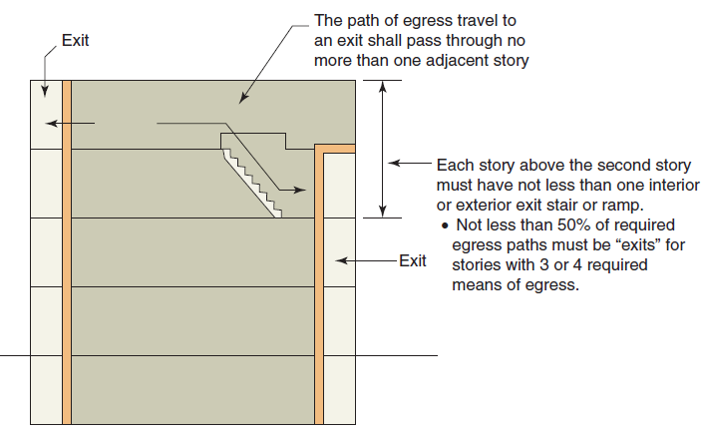
1006, 1007 Numbers of Exits and Exit Access Doorways
The means of egress requirements for stories have been clarified to address the limits of exit access vertical travel until an exit element is reached.

Slide 77
1007.1 Exit and Exit Access Doorway and Stairway Separation
CHANGE TYPE: Modification
The measurement points for separation distance between means of egress elements have been specifically identified.
Between exit or exit access doorways, measured to any point along the width of the doorway.
Between exit access stairways, measured to the closest riser.
Between exit ramps, measured to the start of the ramp run.
Notes:
Specific information is now provided regarding
the point where exit separation is to be measured. In addition, where
three or more means of egress are required, performance language has
been included to ensure the egress paths are adequately separated.

Slide 78
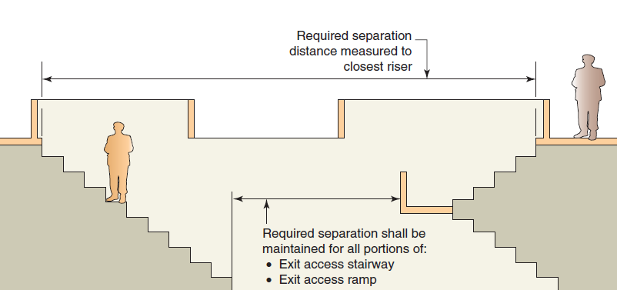
1007.1 Exit Access Stairway Configuration
Notes:
Specific information is now provided regarding
the point where exit separation is to be measured. In addition, where
three or more means of egress are required, performance language has
been included to ensure the egress paths are adequately separated.

Slide 79
1007.1 Exit and Exit Access Doorway Configuration
CHANGE TYPE: Modification
Where access to three or more exits is required, two exit or exit access doorways shall be separated based on the maximum overall diagonal of the area served.
Additional required exit or exit access doorways shall be arranged a reasonable distance apart such that if one becomes blocked, the others will be available.
Performance language in 2000 and 2003 IBCs, but removed in 2006 edition as being too subjective.
Provision reinstated to provide intent and purpose based upon a single fire condition.
Notes:
Specific information is now provided regarding
the point where exit separation is to be measured. In addition, where
three or more means of egress are required, performance language has
been included to ensure the egress paths are adequately separated.

Slide 80
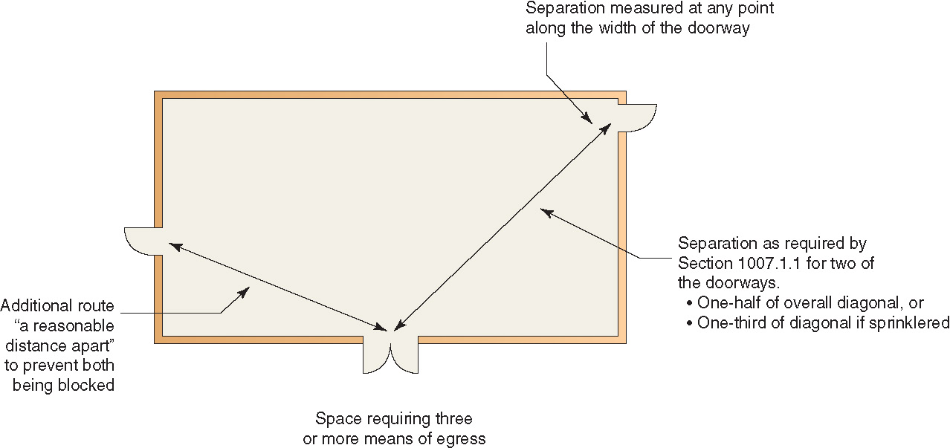
1007.1 Exit and Exit Access Doorway Configuration
Notes:
Specific information is now provided regarding
the point where exit separation is to be measured. In addition, where
three or more means of egress are required, performance language has
been included to ensure the egress paths are adequately separated.

Slide 81
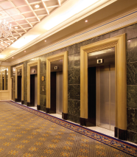
1009.8 Two-Way Communication Systems
CHANGE TYPE: Clarification
It has been clarified that a two-way communication system may serve multiple elevators and that the systems are not required at service elevators, freight elevators or private residence elevators.

Slide 82
1010.1.9 Door Operations— Locking Systems
CHANGE TYPE: Modification
Numerous revisions throughout the locking provisions now help clarify requirements and their application through the use of consistent terminology.
Provisions modified include those for:
Locks and latches
Controlled doors in Groups I-1 and I-2
Sensor release of electrically locked egress doors
Electromagnetically locked egress doors

Slide 83
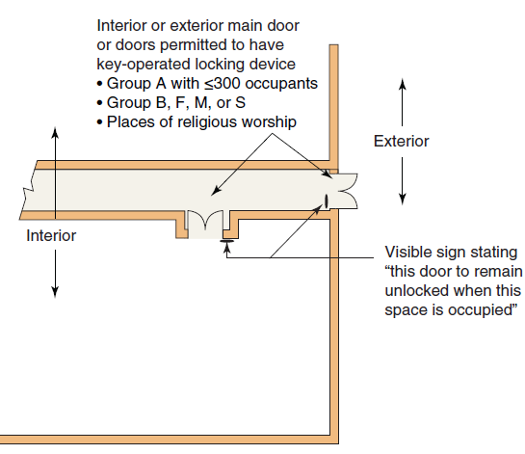
1010.1.9.3 Locks and Latches
Commonly-used key-lock exception now not limited to exterior doors.
Required signage also reflects change in application.

Slide 84
1010.1.9 Door Operations— Locking Systems
Allowances for “controlled egress doors” has been expanded to now also include Group I-1 occupancies.
Previously limited to Group I-2 facilities
“Sensor released electrically locked egress doors,” previously regulated as access controlled doors, now also permitted for use in Groups I-1 and I-4.
Electromagnetically locked egress doors now also permitted for use in Groups I-1, I-2 and I-4.
Other changes to details of use also made.

Slide 85
1016.2, 1020.6 Egress through Intervening Spaces and Corridor Continuity
CHANGE TYPE: Modification
A means of egress is now permitted through an elevator lobby provided access to at least one exit is available without passing through the lobby.
Confirms that travel through an elevator lobby is an acceptable means of egress path.

Slide 86
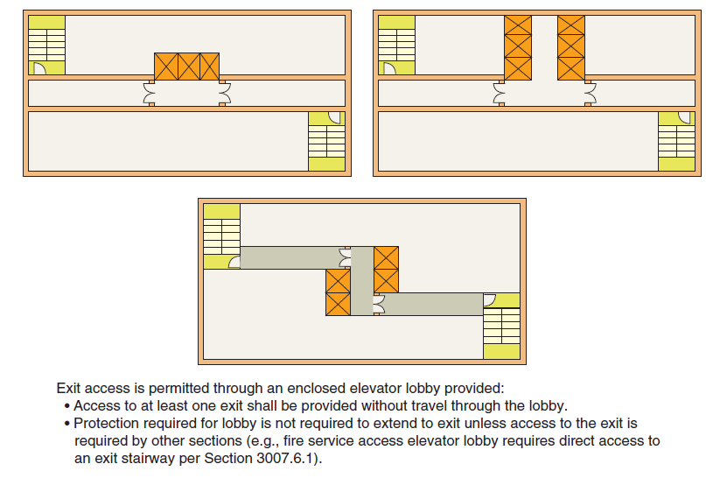
1016.2 Egress through Intervening Spaces

Slide 87
1020.2 Corridor Width and Capacity
CHANGE TYPE: Clarification
A new exception helps to clarify the width requirements for corridors within Group I-2 occupancies for areas where bed or stretcher movement is not necessary.

Slide 88
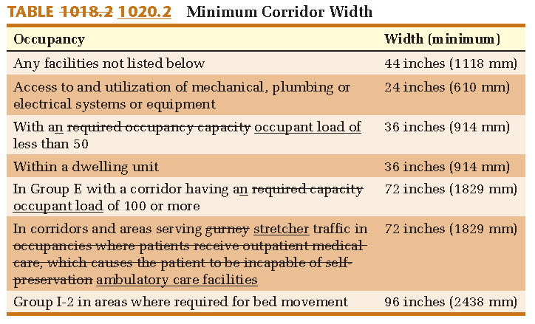
1020.2 Corridor Width and Capacity

Slide 89
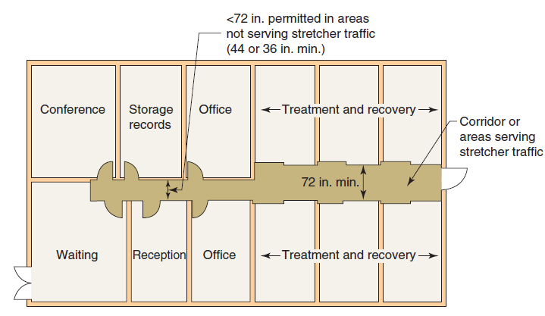
1020.2 Corridor Width and Capacity

Slide 90
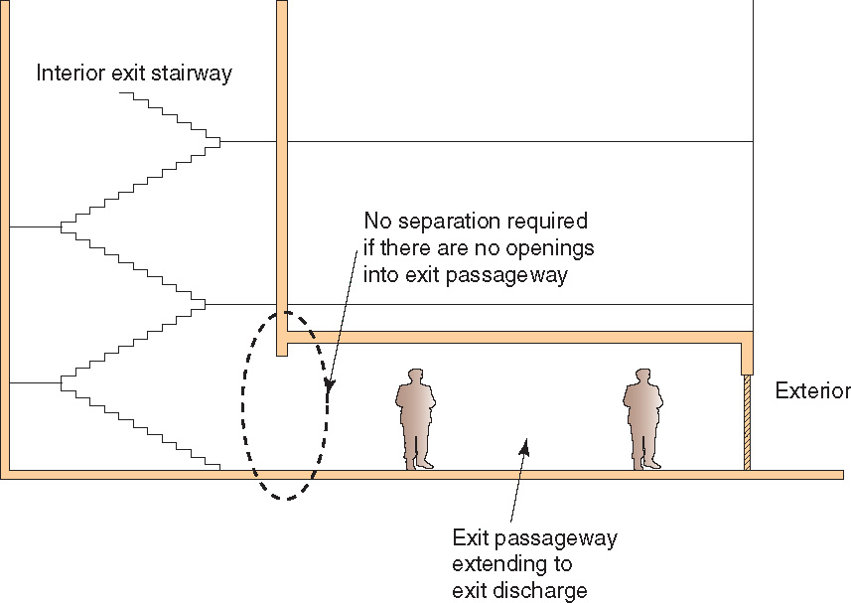
1023.3.1 Stairway Extension
CHANGE TYPE: Modification
An interior exit stairway is now permitted to continue directly into an exit passageway without a required fire door assembly to separate the two elements.

Slide 91
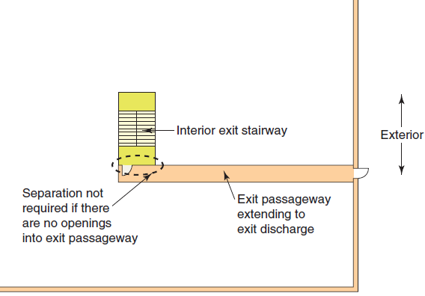
1023.3.1 Stairway Extension
Elimination of fire door assembly only permitted where there are no openings into the exit passageway extension.

Slide 92
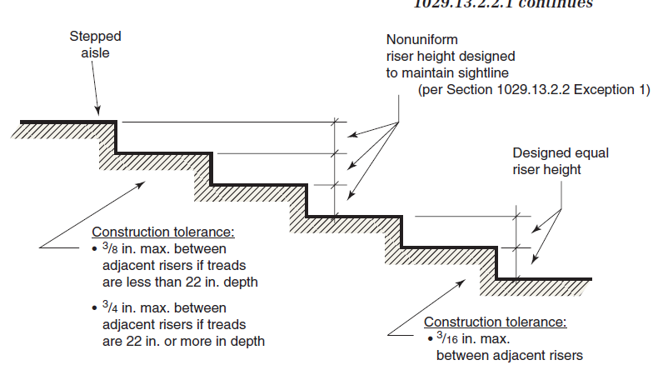
1029.13.2.2.1 Stepped Aisle Construction Tolerances
CHANGE TYPE: Modification
The variation allowed between adjacent risers within a stepped aisle is now limited.

