Slide 1
The 38th Annual
March 28th, 2019
STATE CONSTRUCTION
CONFERENCE
Agenda
1:00 ► Design Build P3 (Public, Private, Rep. Dean Arp, PE; Paul Boney, FAIA – LS3P; Mark Bondo – OSBM; Partnership) – Panel Discussion Marty Moser – Barnhill Contracting Company
3:00 ► Design Build P3 (Public, Private, Rep. Dean Arp, PE; Paul Boney, FAIA – LS3P; Mark Bondo - OSBM Partnership) – Panel Discussion Marty Moser – Barnhill Contracting Company

Slide 2
Paul Davis Boney, FAIA LS3P
Latif Kaid State Construction Office
Will Johnson First Down Strategies
Mark Bondo OSBM
Marty Moser Barnhill Contracting Company
2

Slide 3
INNOVATIONS COMMITTEE
P3 SUB COMMITTEE
The Innovations Committee was established by the State Building Commission to assist the Director of the State Office of Construction with issues related to the built environment in North Carolina.
3

Slide 4
INNOVATIONS COMMITTEE
P3 SUB COMMITTEE
28 MARCH 2019
Betsy Bailey
Mark Cooney
Dave Simpson
Dave Crawford
Dorrine Fokes
Greg Driver
Joe Walker
Ken Pearce
Ken Yelverton
Latif Kaid
Mark Edwards
Katherine Lynn
Steve Martin
Marty Moser
John Muter
Paul Boney - Chairman
Miriam Tripp
Nathan Maune
Mike O’Connor
Paul Sullivan
Phil Jones
Raynor Smith
Sarah Towles
Sid Stone
Tammie Hall
Valoree Eikinas
Victor Stephenson
Will Johnson
William E. Bagnell
Zack Abegunrin
Mark Bondo
Latif Kaid – Director of State Construction
Mark Edwards – Deputy Secretary DOA
4
Notes:
The “D” fund has been established to provide additional funds (beyond the actual fee from the client) to assist in taking a project to a higher level of design quality.

Slide 5
ARTICLE 8
Public Contracts
G.S. 143-128. Requirements for certain building contracts
(a1) Construction methods. – The State, a county, municipality, or other public body shall award contracts to erect, construct, alter, or repair buildings pursuant to any of the following methods:
(1) Separate-prime bidding.
(2) Single-prime bidding.
(3) Dual bidding pursuant to subsection (d1) of this section.
(4) Construction management at risk contracts pursuant to G.S. 143-128.1.
(5) Alternative contracting methods authorized pursuant to G.S. 143-135.26(9).
(6) Design-build contracts pursuant to G.S. 143-128.1A.
(7) Design-build bridging contracts pursuant to G.S. 143-128.1B.
(8) Public-private partnership construction contracts pursuant to G.S. 143-128.1C.
5

Slide 6
BY DEFINITION
Public-Private Partnerships | P3
A P3 is a financial delivery method utilizing one of the approved construction delivery methods:
Single Prime
Multiprime
Design-Build
Design-Build Bridging
CM@Risk
6
4

Slide 7
GOAL OF THIS STUDY
Public-Private Partnerships
To Educate Potential End Users
Provide a Framework and the Facts on P3 Projects
Provide Documents That the State Can Use for P3 Projects
7

Slide 8
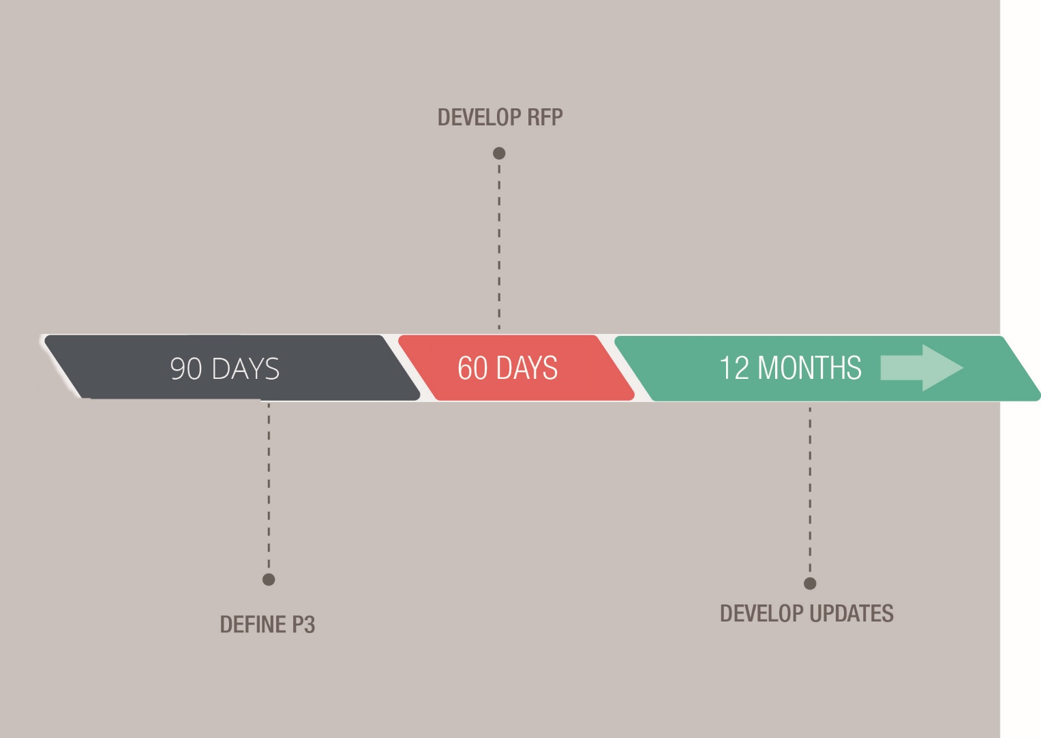
SCHEDULE
Public-Private Partnerships – Tasks
P3
Task 1 (August – October)
Define P3
Identify Type of P3
Define Legislative Authority Under Which Public Entities Can Enter Into a Contract
Define Types of Financing
Task 2 (November – December)
Develop a Generic RFP (QBS Selection w/ Brook Act)
Task 3
Develop Updates to the Current P3 Statue by Legislature
24
8
3

Slide 9
RFQ DRAFT
Public-Private Partnerships
P3
9

Slide 10
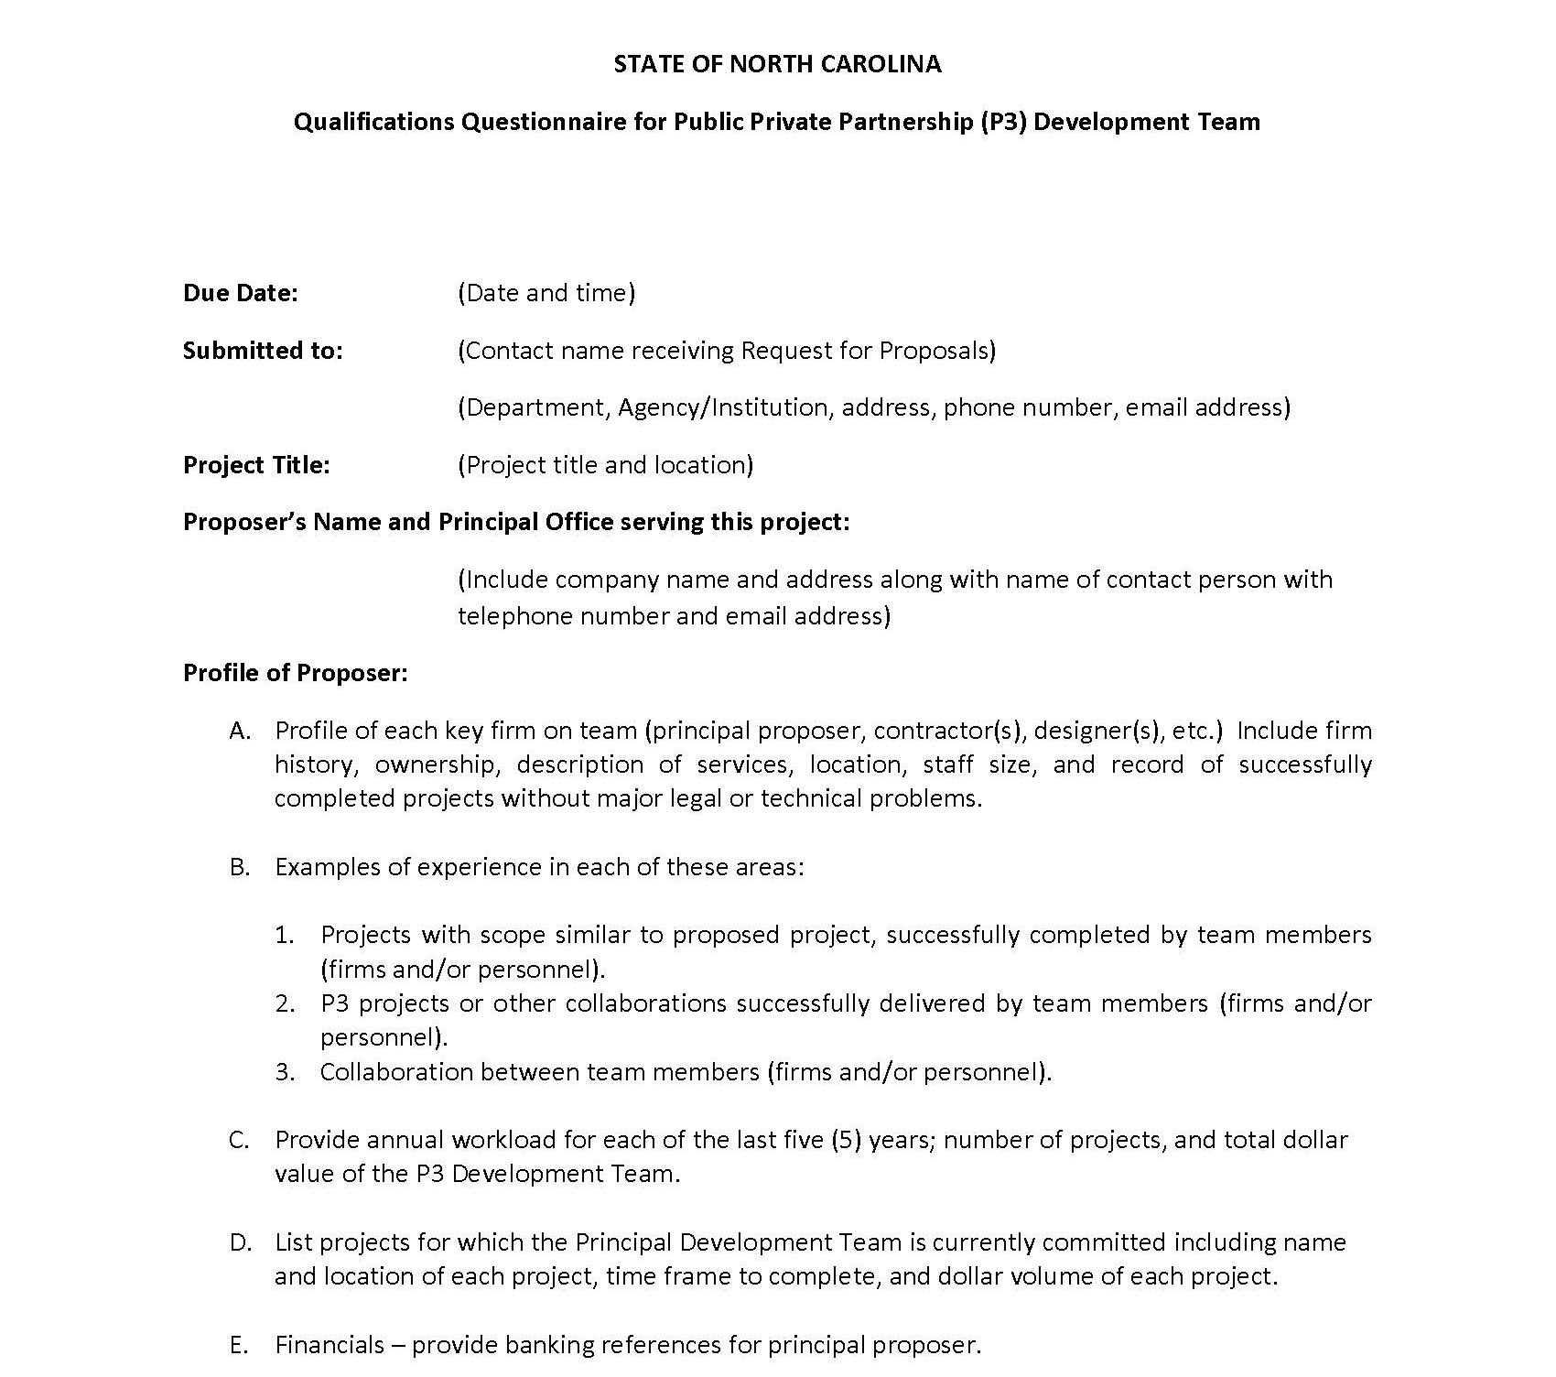
RFQ DRAFT
Public-Private Partnerships
P3
10

Slide 11
Latif Kaid
Director
State Construction Office
11

Slide 12
G.S. 143-128.1C (a)(8) Public-private project
Public-Private Partnerships | P3
G.S. 143-128.1C (a)(8) Public-private project. – A capital improvement project undertaken for the benefit of a governmental entity and a private developer pursuant to a development contract that includes construction of a public facility or other improvements, including paving, grading, utilities, infrastructure, reconstruction, or repair, and may include both public and private facilities.
For UNC institutions, this may not be quite as relevant as it is for other state agencies and local governments because of the UNC exemption under 143-128.1C(m).
12
5

Slide 13
G.S. 143-128.1C:
Public-private partnership construction contracts.
Partnership between:
Governmental Entity
Private Developer
Contractor(s)
Finance institution(s)
Governmental Entity can pursue a P3 based on critical need.
A private Body can pursue a P3 only after an Open Meeting following Article 33C of NC GS.
A P3 contract can be for:
Constructing
Owning
Leasing
Operating
13

Slide 14
G.S. 143-128.1C:
Public-private partnership construction contracts.
Private Developer has to comply with the Good Faith Effort per GS 143-128.2, 143-128.4 and to recruit and select small business entities.
Private Developer can self-perform only when both apply:
A contractor defaults and a replacement cannot be obtained after a good faith effort has been made in a timely manner.
The Government Entity approves the Private Developer to perform the work.
Bonding requirement:
100% Payment Bond of the total anticipated amount of construction (design and construction).
Surety Company(ies) to be legally authorized to do business in the State of North Carolina.
The obligations and lien of rights set forth in Article 2 of Chapter 44A of GS apply. Private Developer is deemed the owner on the private side of the contract.
14

Slide 15
G.S. 143-128.1C:
Public-private partnership construction contracts.
Governmental Entity shall advertise, based on their programming, a notice for interested Private Developers:
Private Developer’s proposal to include:
Evidence of financial stability.
Experience with similar projects.
Explanation of project team selection: Licensed.
Statement of availability to undertake this project P3 project.
Any other information required by the Government Entity.
Governmental Entity may select one or more Private Developer to negotiate the terms and conditions of a P3 contract.
15

Slide 16
G.S. 143-128.1C:
Public-private partnership construction contracts.
Government Entity shall advertise the terms of the proposed contract:
Newspaper within the county in which the governmental entity is located at least 30 days prior to entering into the development contract.
Make available a summary of the development contract terms.
Leases and other agreements are subject to approval as follows:
If a capital lease is entered by a local government unit, that capital lease is subject to approval by the local government commission under Article 8 of Chapter 159 of the General Statutes.
If a capital lease is entered into by a State entity, that capital lease shall be subject to the approval procedures required for special indebtedness by G.S. 142-83 and G.S. 142-84.
This section does not apply to any contract or other agreement between or among The University of North Carolina or one of its constituent institutions, a private, nonprofit corporation established under Part 2B of Article 1 of Chapter 116 of the General Statutes.
16

Slide 17
Will Johnson
First Down Strategies
17

Slide 18
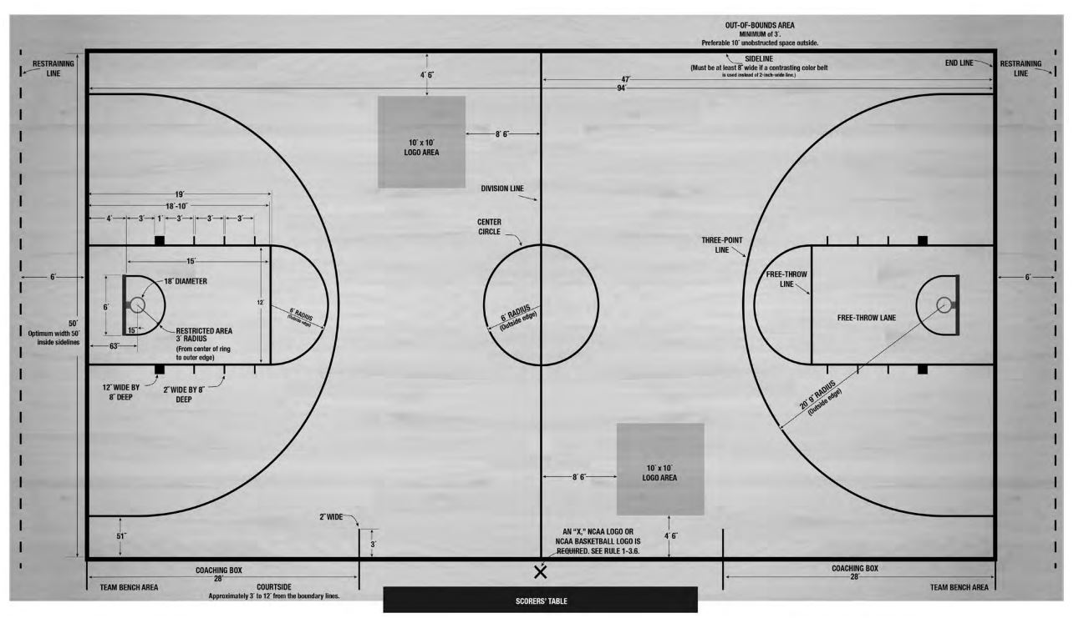
18

Slide 19
FINANCING & DOCUMENT STRUCTURE
University Public-Private Partnerships
19

Slide 20
FINANCING & DOCUMENT STRUCTURE
University Public-Private Partnerships
20

Slide 21
FINANCING & DOCUMENT STRUCTURE
University Public-Private Partnerships
21

Slide 22
22

Slide 23
B E F O R E you P A Y to P L A Y…
#1
What is the TOTAL PROJECT COST?
#2
What is the ANNUAL OPERATING COST?
#3
What FUNDING SOURCE pays for the total project cost and annual operating cost?
#4
Who MANAGES the project for 30-40-50 years?
#5
Who OWNS the project at the end of the agreement?
23

Slide 24
Mark Bondo
Budget Analyst
Statewide Analysis / Capital / Transportation Budget
Office of State Budget and Management
24

Slide 25
FINANCIAL ISSUES TO CONSIDER
Public-Private Partnerships
P3’s are more of a financing mechanism and “business deal.”
Involve risk transfer (which you will pay for or benefit from)
Involve giving up or retaining control (which you will pay for or benefit from)
Can be more expensive than traditional finance
Needs to be analyzed completely
Needs to be evaluated with an eye toward failure (to ensure adequate transfer of risk).
25

Slide 26
Marty Moser
Barnhill Contracting Company
26

Slide 27
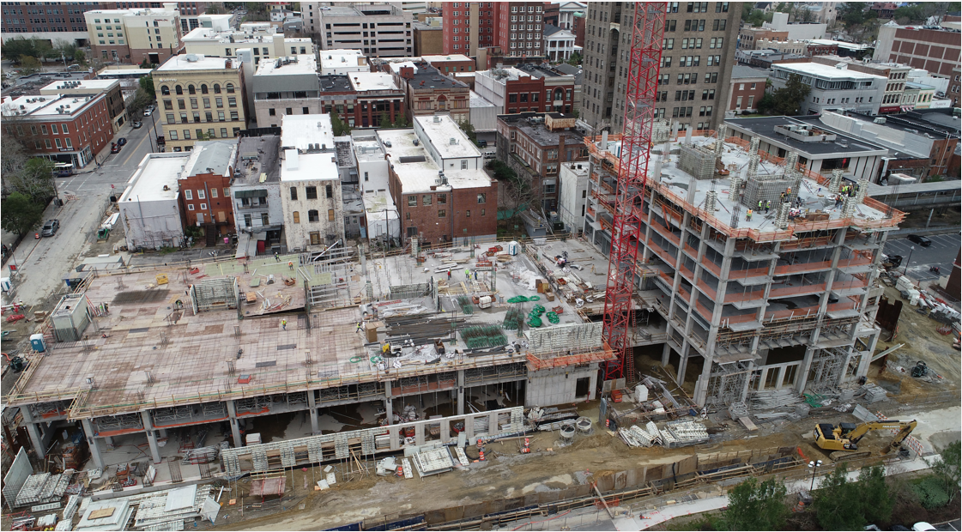
Case Study:
Public Private City of Wilmington Water Street Parking Deck
Partnership
27

Slide 28
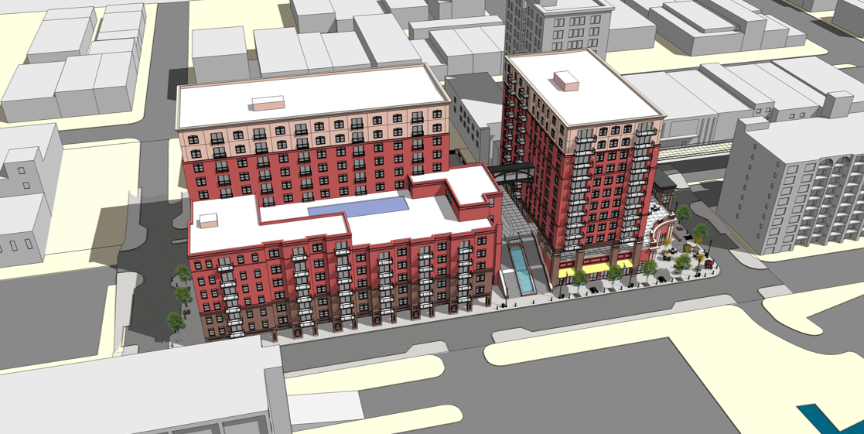
The Process
Pre-Development Process: 2013 (12 month duration)
Economic Feasibility
Market Analysis
Site Analysis
Financial Feasibility Model
Public Stakeholder Engagement
Develop Solicitation & Recent Developer Proposals
28

Slide 29
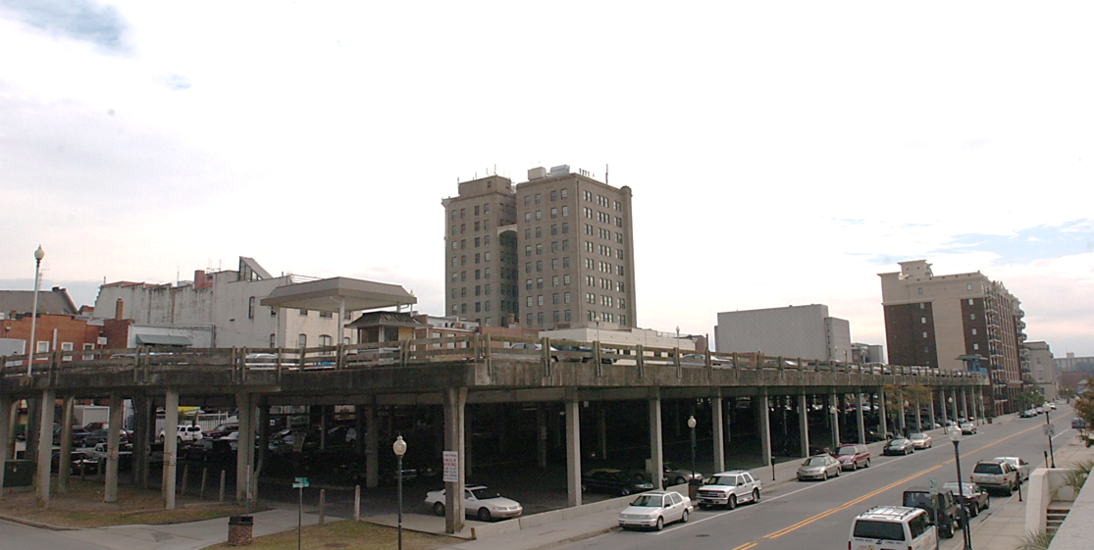
Pre-Development
considerations
Replace Existing Aging Parking Deck
Redevelop 1.2 acre parcel as Mixed-Use
Increase Parking for Downtown
Create new public spaces
Connectivity to Water Street & Waterfront
Add Retail & Residential/Hospitality
29

Slide 30
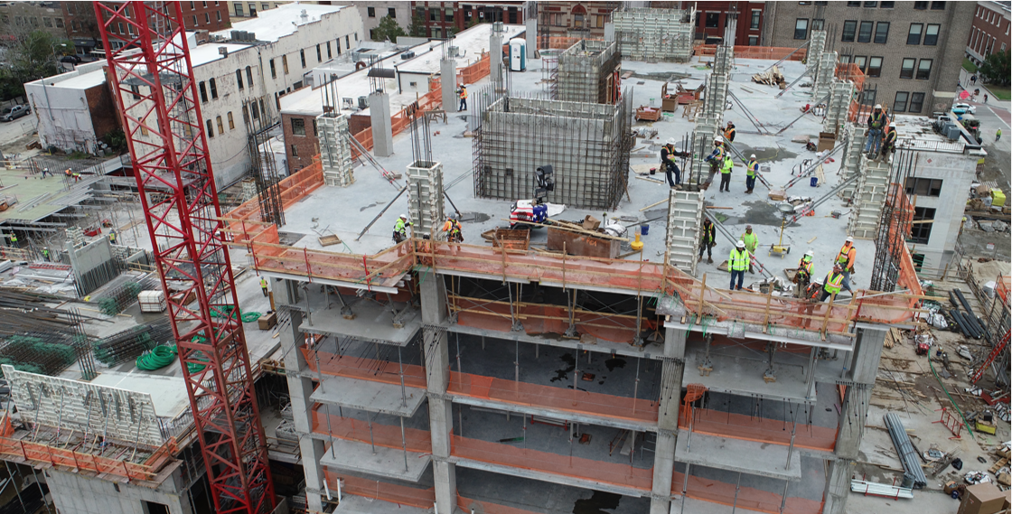
The solicitation
Submissions in October 2014:
8 Developer Proposals Received
Submission Requirements
Introduction
Program & Concepts
Development Team & Experience
Financial Capacity
Interview Teams
Shortlist to 3 Firms
Final Selection by City Council
March 2015
30

Slide 31
Purchase &
Development
Agreement
City owns parcel
Developer for services parking, site & other C.I.P’s (manage, plan, develop, construct)
Developer Purchase Air Rights
Developer Provides Financing for Retail/Residential
Cost Allocations on Common Systems
Total Development Costs: $83.5M
72% by Developer
28% by City
31

Slide 32
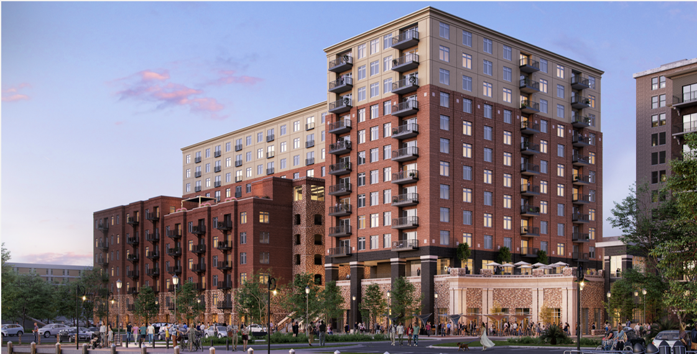
Final project
Development
scope
409 Parking Spaces
164,745 SF of Parking Space
31,287 SF of Retail Space
79 Residential Units (For Lease)
92 Residential Units + 4 Penthouse Units (For Sale)
498,616 SF Total Building Size including amenities
32

Slide 33
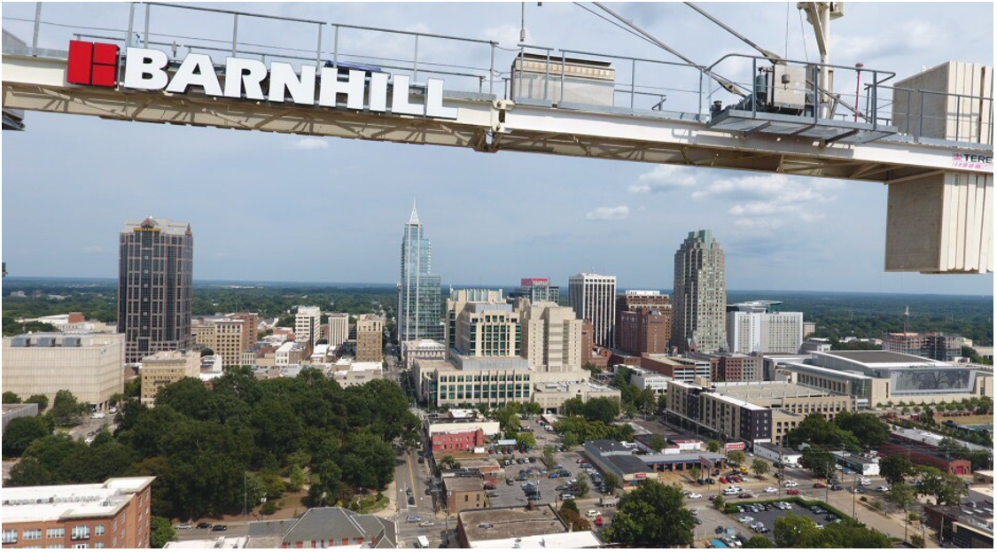
QUESTIONS?
Marty Moser
mmoser@barnhillcontracting.com
www.barnhillcontracting.com

Slide 34
QUESTIONS FOR THE PANEL?
Paul Boney
PaulBoney@LS3P.com
www.LS3P.com
Latif Kaid
Latif.kaid@doa.nc.gov
www.DOA.NC.gov
Will Johnson
Will@FirstDownStrategy.com
www.FirstDownStrategy.com
Mark Bondo
Mark.Bondo@OSBM.NC.gov
www.OBM.NC.gov
Marty Moser
MMoser@BarnhillContracting.com
www.BarnhillContracting.com

