Slide 1
MWBE Grant Funds Solicitations 38th Annual State Construction Conference March 28, 2019
Norma Houston UNC School of Government | Tammie E. Hall Office for Historically Underutilized Businesses
Notes:
Tell us where you’re from and how many are viewing at your site
Other housekeeping instructions (Norma read moderator script)

Slide 2
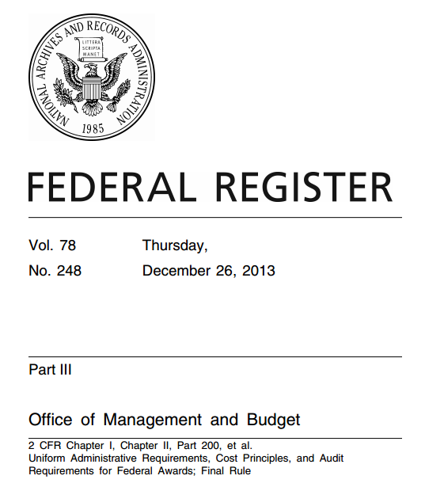
Uniform Guidance (UG) Overview

Slide 3
What is the Uniform Guidance?
Rules that set uniform standards for the award and expenditure of federal financial assistance (grants and loans)
UG supersedes previous rules/OMB Circulars (ex: A-102, A-133)
UG codified at 2 CFR Part 200
Procurement standards codified at 2 CFR 200 Subpart D (§§ 200.317-326)
Notes:
Adopted December 2013 and went into effect in 2014; grace period for local governments and non-profits extended to December 2017.

Slide 4
Who Does the UG Apply To?
“Non-federal entities” that receive federal financial assistance – states*, nonprofits, Indian Tribes, universities* and colleges, and local governments
City and County
School District
Public Authority and Special District
Council of Government
Any other “political subdivision”
*UG procurement requirements do not apply to state agencies and public universities,
but other provisions of UG do apply
Notes:
Definition of non-federal entity on screen comes from federal code. Note that it includes states, nonprofits, Indian tribes, universities and colleges, and local governments
So who is a local government? Basically, in North Carolina terms, any political subdivision of the state, meaning a governmental entity that is not a state agency.

Slide 5
Who Does the UG Apply To?
Recipients and all subrecipients are covered
Federal agency
State
agency
Local Government
Nonprofit
State Agency allocates funds to Local Government
UG applies
Local Government expends the funds
UG applies
Local Government allocates funds to subrecipient
UG applies
Notes:
States follow their own procurement requirements, but are subject to other provisions of the UG such as monitoring and compliance requirements
Nonprofit covered also if state allocates directly to nonprofit

Slide 6
Which Programs are Covered?
UG applies to most (but not all) categories of federal financial assistance programs
Not all federal programs are covered
Not all parts of the UG apply to all categories of covered funds
ASSUME THE UG APPLIES UNLESS THE GRANTOR AGENCY ADVISES OTHERWISE!
Notes:
Assume UG applies unless federal grantor agency confirms otherwise-
Treasurer’s Office Addendum to Memo 2018-06 provides this guidance
Jim discuss specific grants
Ex: USDA loans NOT covered/USDA grants ARE covered

Slide 7
Why Is This Important?
Noncompliance with state and federal procurement requirements most common reason for sanctions
Notes:
2 C.F.R. § 200.338:
(1) Requiring payments as reimbursements rather than advance payments;
(2) Withholding authority to proceed to the next phase until receipt of evidence of acceptable performance within a given period of performance;
(3) Requiring additional, more detailed financial reports;
(4) Requiring additional project monitoring
(5) Requiring the non-Federal entity to obtain technical or management assistance;
(6) Establishing additional prior approvals.

Slide 8
Sanctions & Consequences
Fiscal Disaster
Deobligation of Funds
Payments temporarily withheld
Recovery work not reimbursed
Suspending federal award
Negative Publicity
State and federal investigation
Debarment from further awards
Notes:
2 C.F.R. § 200.338:
(1) Requiring payments as reimbursements rather than advance payments;
(2) Withholding authority to proceed to the next phase until receipt of evidence of acceptable performance within a given period of performance;
(3) Requiring additional, more detailed financial reports;
(4) Requiring additional project monitoring
(5) Requiring the non-Federal entity to obtain technical or management assistance;
(6) Establishing additional prior approvals.

Slide 9
Example: FEMA Reimbursement Pitfalls
Noncompliance with federal procurement requirements most common reason for FEMA PA reimbursement denial
OIG found over $500 million in ineligible PA costs due to procurement violations (2015-17)

Slide 10
FEMA Top 10 Procurement Mistakes
Bidding requirements (noncompetitive contracting)
Sole source beyond exigent circumstances
Piggybacking
Time and materials contract
Cost-plus contract
Missing contract clauses
Geographic preference
MWBE solicitation
No cost/price analysis
Inadequate/lack of documentation

Slide 11
Construction and Repair Requirements
Formal Bidding
Formal Bidding
+ Sealed Bid
*Federal thresholds
Sealed Bid
Competitive Proposals
(RFP)
$500,000
Informal Bidding
Sealed Bid
Cost of Contract
$250,000*
Small Purchase
Small Purchase
$30,000
No Method
$10,000*
$0
Micro Purchase
Micro Purchase
State
UG
Most Restrictive
Even when generally following federal rules, some specific state requirements may still apply and vice versa.

Slide 12
Which Set of Rules Do I Follow?
Follow the “Most Restrictive Rule”
If rules are different but neither is more restrictive than the other, follow federal rules
Even when generally following federal rules, some specific state requirements may still apply . . . . . . . and vice versa

Slide 13
UG MWBE solicitation requirements

Slide 14
MWBE / HUB Participation
Not a quota or set-aside
Focuses on opportunity to compete for contracts
Lowest responsive, responsible bidder standard still applies
Non-discrimination in contract award still applies
Cannot require bidder to hire sub who is not lowest responsive, responsible bidder

Slide 15
Who is MWBE?
Key Terms:
Minority Business
Women’s Business Enterprise
Labor Surplus Area Firm
Terms not defined in the UG
Check federal grantor definitions
If not defined by grantor agency, follow state law definitions

Slide 16
Requirements
UG (MWBE)
State (HUB)
Applies to ALL contracts regardless of type above micro-purchase threshold ($10,000)
Requires 6 specific solicitation steps
Local government engages in outreach efforts for all building construction contracts costing $30,000 and above
Require bidders to engage in good faith efforts for all building construction contracts costing $300,000 and above

Slide 17
HUB and MWBE Requirements
Formal HUB
MWBE Requirements
Formal
HUB
MWBE Requirements
Sealed Bid
Competitive Proposals
(RFP)
*Federal thresholds
$300,000
Informal HUB
Informal HUB
$250,000*
Cost of Contract
$30,000
None
None
$10,000*
$0
Micro Purchase
Micro
State
Building construction contracts only
UG
ALL contracts over micro-purchase threshold
Combined
Must comply with State (building construction) & UG (all contracts)

Slide 18
UG MWBE “6 Steps” 2 CFR § 200.321
Put MWBEs on bidders list
Include MWBEs in bid solicitations (recommend posting all bids on HUB website)
Where economically feasible, divide project into smaller contracts to encourage MWBE participation
Where feasible, establish delivery schedules to accommodate MWBEs
Use services of SBA, US Dept. of Commerce Minority Development Agency, and other similar agencies such as NC HUB Office
Require prime contractors to comply with steps 1-5 above where subcontractors are used
Notes:
Items in red (on click) mirror state HUB good faith efforts. Items 3 and 4 are “where feasible”

Slide 19
Goals
UG does not require MWBE goals
State law requires goals for building construction projects:
$300,000 with local funds
$100,000 with state funds
State goal is 10%
Some federal programs require goals (ex: DBE goals for US DOT projects)
FEMA Public Assistance Program does not require goals

Slide 20
Documentation and Reporting
UG
State
Must document compliance with MWBE solicitation requirements (along with all other procurement requirements)
Recommend requiring contractors to document their compliance
HUB certification of firms not required for compliance
Formal HUB – bidder’s good faith efforts affidavits
Must report to NC HUB office
HUB certification required for credit toward participation goals

Slide 21
How Can YOU Help With Compliance?
Become familiar with the UG “6 steps”
Educate your colleagues and vendors/bidders on these requirements
Develop compliance documentation forms
For your unit of government
For instructions to bidders
Develop record-keeping system to document compliance
Review procurement policies to ensure UG “6 steps” are included for contracts paid for with federal funds

Slide 22
Resources – HUB Office
https://ncadmin.nc.gov/businesses/hub
Post on the HUB website:
Bids for ALL contracts costing $10,000 or more
Subcontractor solicitations

Slide 23
Resources – School of Government
www.ncpurchasing.unc.edu
www.sog.unc.edu/ncem

Slide 24
Norma Houston UNC School of Government nhouston@sog.unc.edu | Tammie E. Hall Office for Historically Underutilized Businesses tammie.hall@doa.nc.gov

