Slide 1
Motor Fleet Management
VEHICLE SERVICES
This Photo by Unknown Author is licensed under CC BY-SA

Slide 2
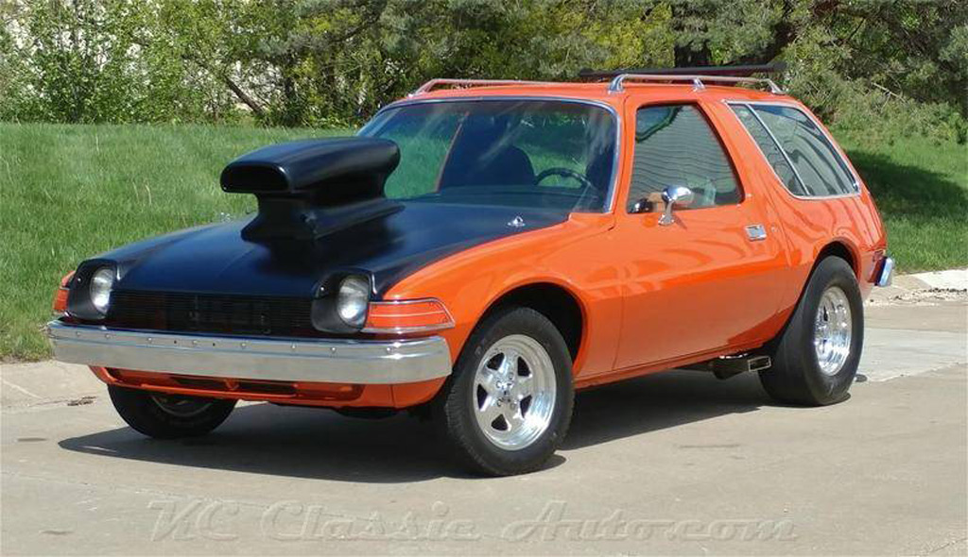
We Keep You On The Road

Slide 3
Motor Fleet/Driver Partnership
Motor Fleet:
Insure vehicles are properly maintained and are safe to operate
Repair vehicles in a timely manner
Communicate important information with the vehicle operator
Vehicle Operator:
Insure vehicle is serviced at the designated intervals
Report all mechanical issues
Respond to all safety recall notices
Drive it like you own it

Slide 4
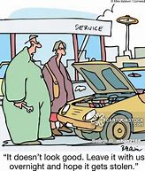
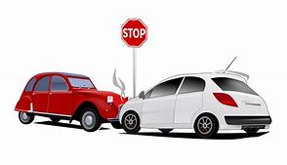
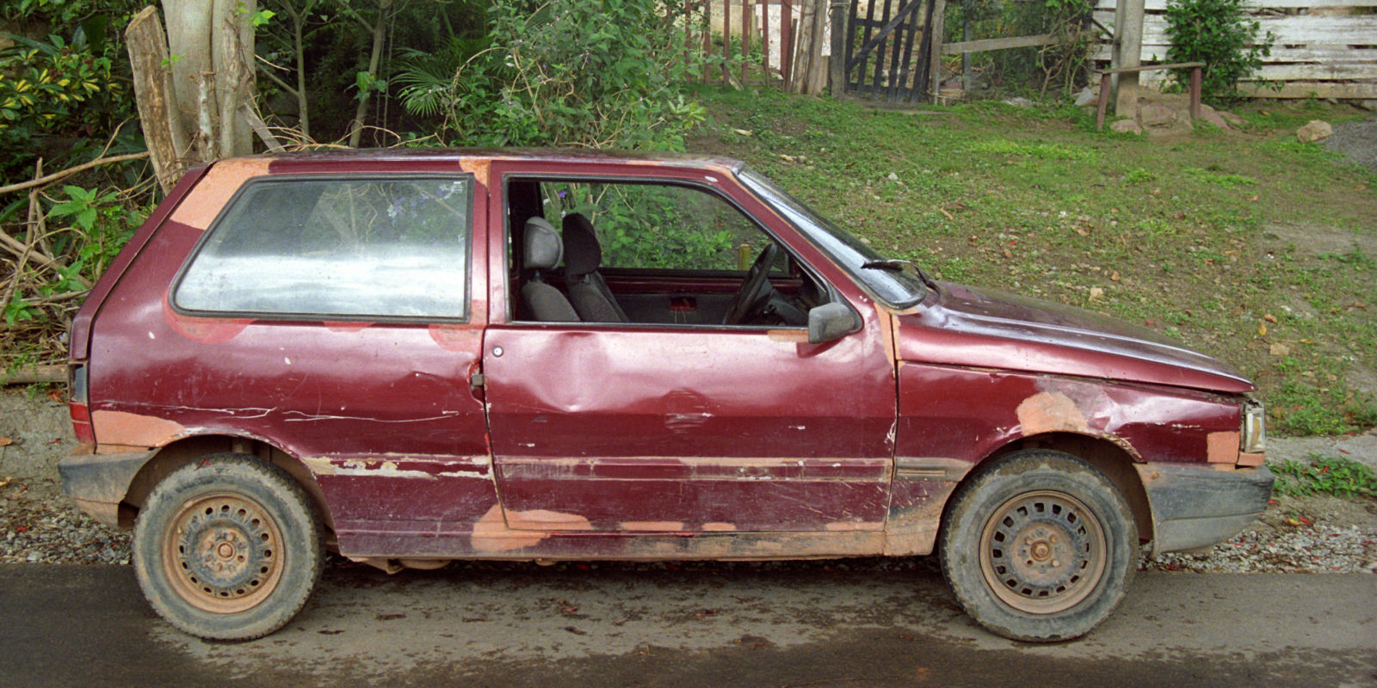
Vehicle Services
Vehicle Repair and Service
Vendor Management
Accident Reporting and Management
Vehicle End of Life processing

Slide 5
Resources
Motor Fleet Vehicle Services staff
Karl Vogeley: Fleet Systems and Repair Administrator
David Denton: Fleet Shop Manager
Motor Fleet Garage
Corey Brandon: Parts Supervisor
Greg Dunn and George Partin Fleet Shop Service Writers
Vendors via ARI

Slide 6
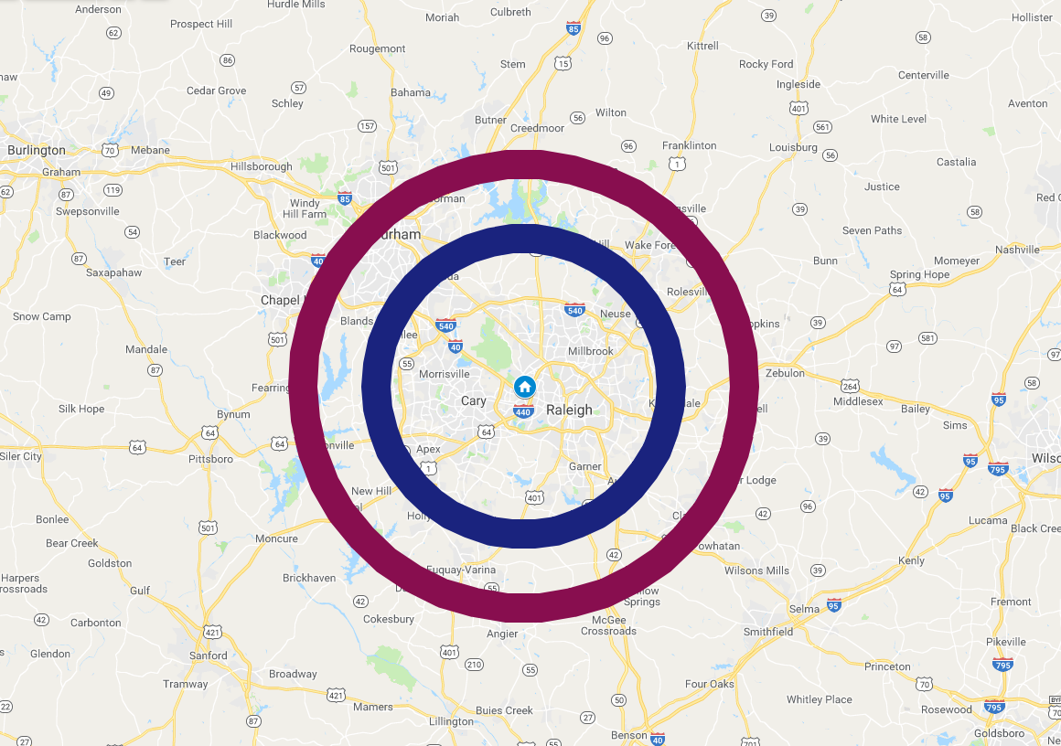
Vehicle maintenance and Repair
20 miles or less from MFM = Blue Ridge shop for all vehicle needs
20 miles to 30 miles = Heavy work comes to Blue Ridge shop

Slide 7
Vehicle Service at Blue Ridge Road
Contact Appointments office via phone or email:
919-857-4046/4047
SVC_service@mfm
PM Services
Repairs
Tires
Warranty work
Recalls
Loaner Vehicle (limited Availability)

Slide 8
Vehicle Service and Repair Outside of Bullseye
Contact ARI hotline
800-227-2273
Have Vehicle Number ready
Be specific on needs
ARI will direct driver to authorized vendor

Slide 9
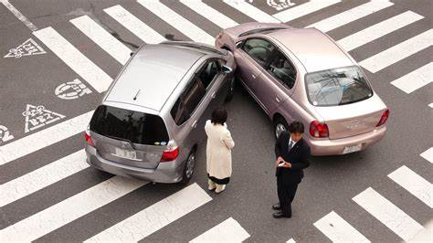
Accidents
Secure accident scene
Call 911 if injuries
Call Police and get report #
Take pictures of immediate scene
Exchange information
Call ARI and report accident
Only if we damaged other property: file on-line Travelers report
Submit FM-16 MFM accident report

Slide 10
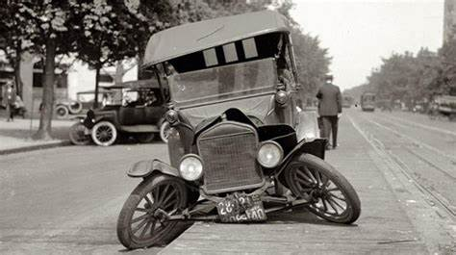
Emergency Road Service
Contact ARI Maintenance Line 24 hours
Life Threatening Situation call 911

Slide 11
End of Life Vehicle Processing
Vehicle must have all special equipment removed prior to transport to MFM
In the event of a totaled or unrepairable vehicle; the vehicle will be towed to MFM and equipment removed there.

Slide 12
Remember:

Slide 13
Questions?

