Slide 1
37th Annual State Construction Conference March 29th, 2018
Inspection Discoveries

Slide 2
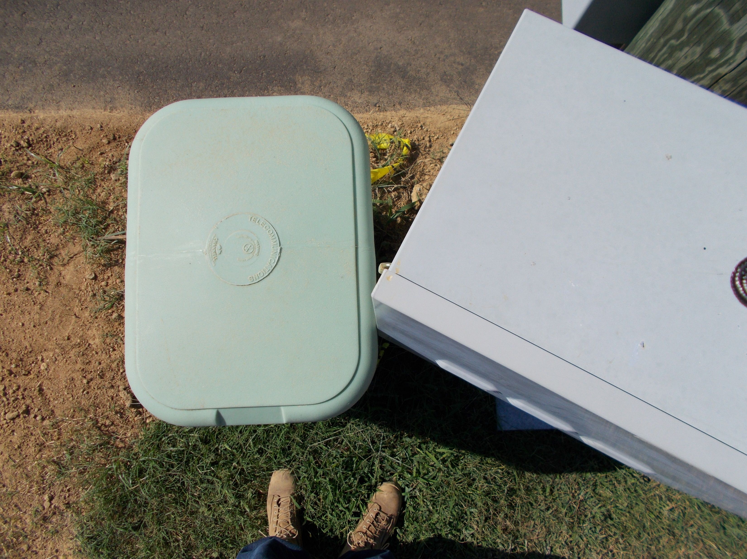
Door hinges debacle

Slide 3
Ventilation – checked Floor deck design - checked

Slide 4
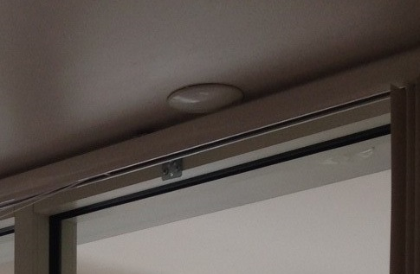
Wall wash compromised

Slide 5
Exit is protected

Slide 6
Are those trees to remain?

Slide 7
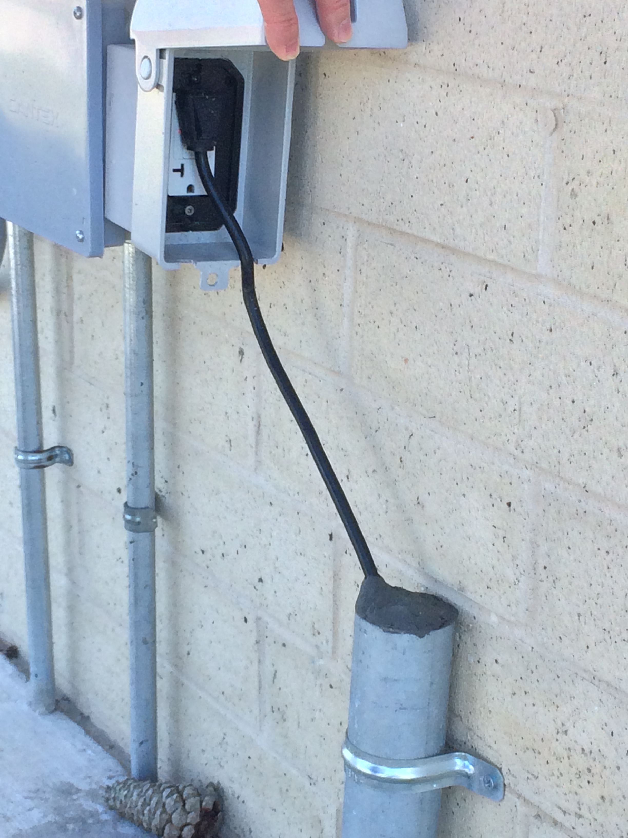
There is a reason why appliances cords are 6 feet long

Slide 8
Better than having another roof penetration

Slide 9
How high should it be? 6 feet?

Slide 10
One of the reasons MC cables should not used

Slide 11
are MC cables exempt?

Slide 12
Not exempt, but no UL detail to follow

Slide 13
EMT is not exempt either

Slide 14
who is going to pay for the damages?

Slide 15
Nice trimming job

Slide 16
Structural engineer said it’s fine?

Slide 17
Fire proofed smoke head!

Slide 18
Sprinkler head protected permanently

Slide 19
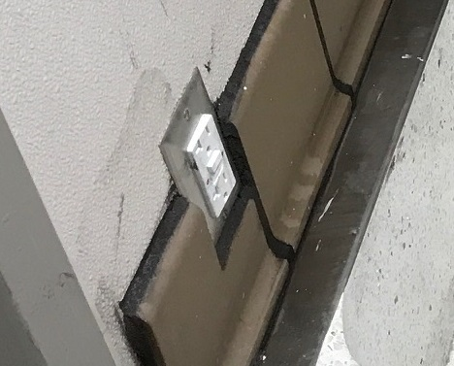
What will the janitor think?

Slide 20
It’s OK, just temporary

Slide 21
Quick fix, This is just wrong

Slide 22
Can you Find the recessed light?

Slide 23
So the roof can breath

Slide 24
Going around your elbow(s)

Slide 25
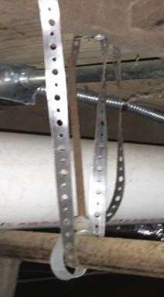
Shortcut, but it works

Slide 26
Inspections are important

Slide 27
Knuckle buster

Slide 28
If it’s clear to the reviewer it will be clear to the contractor
APPROVED

Slide 29
37th Annual State Construction Conference March 29th, 2018
Thank you
Questions? Send email to
Latif.kaid@doa.nc.gov

